Slide 1
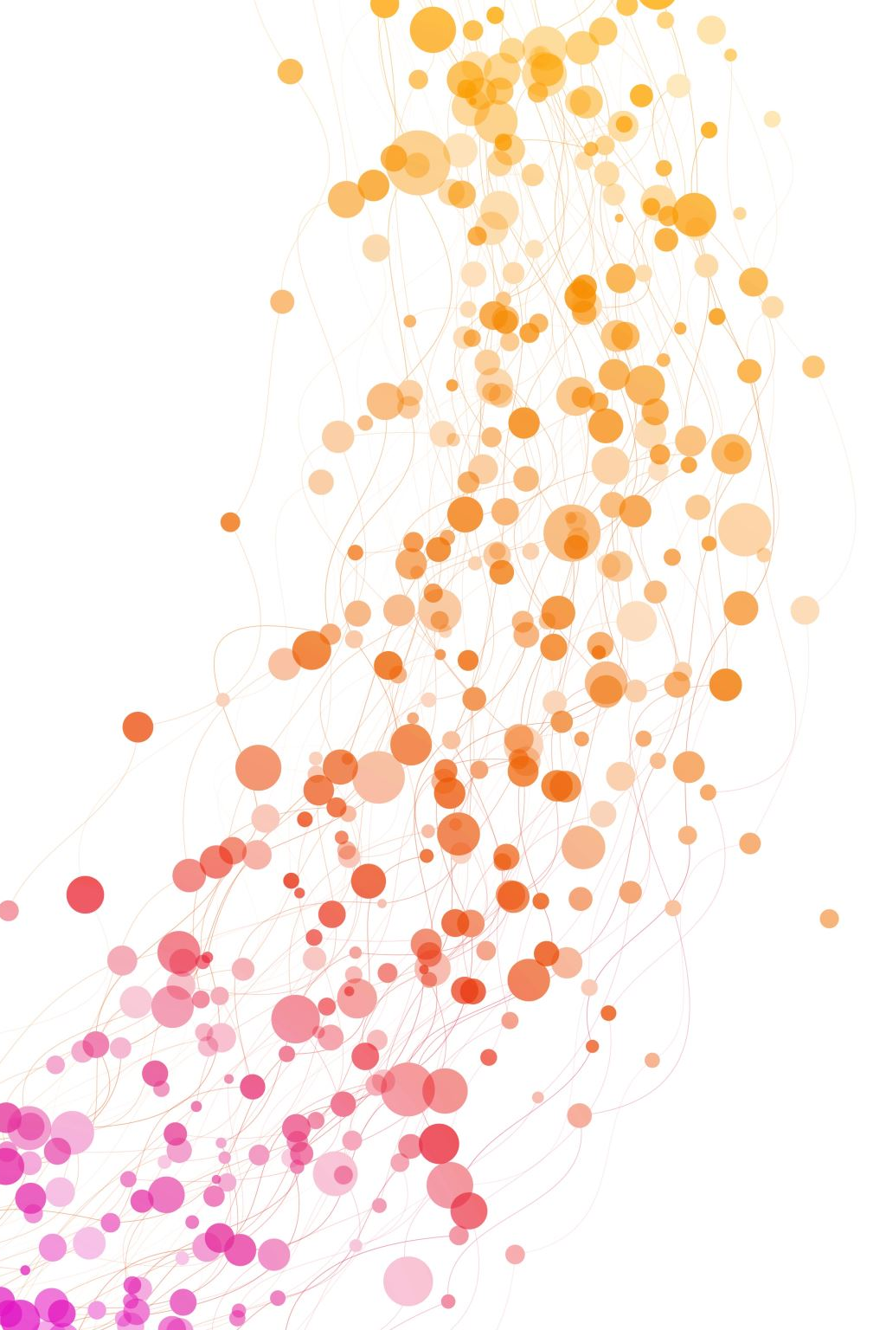
Self study tool: Washington’s Public Hospital Districts Is a PHD right for your community?

Slide 2
Contents – Part 1
Background
What is a PHD?
PHD Locations & Services
PHD Powers & Duties
PHD Funding
Difference between a PHD and Public Health District

Slide 3
Contents – Part 2
How a PHD is formed
Process
Timeline
Implementation
Other Resources

Slide 4
What is a Public Hospital District?
Public Hospital Districts (PHDs) are
Special purpose districts, authorized by RCW 70.44
Approved by voters of the PHD area
Partially tax-funded; mostly insurance-funded

Slide 5
As a Governmental Agency, a PHD is
Governed by an elected Board of Commissioners
Subject to WA State Open Meetings Act

Slide 6
PHD Services
PHDs can provide various health services, according to community needs and as approved.
These may include:
Hospitals
Clinics
Emergency Services
Other types of services in each case

Slide 7
PHDs Currently in WA State
Locations:
58 Districts
26 Western WA
31 Eastern WA

Slide 9
Acute Care Services
Hospitals: 40 (31 Critical Access)
18 Western WA
22 Eastern WA
EMS: 17
5 Western WA
12 Eastern WA

Slide 10
Clinics
Behavioral Health: 11
4 Western WA
7 Eastern WA
Medical Clinics: 14
9 Western WA
5 Eastern WA
Wellness Services: 5
5 Western WA
0 Eastern WA

Slide 11
Extended Care
Skilled Nursing Facilities: 6
1 Western WA
5 Eastern WA
Long Term Care: 1
0 Western WA
1 Eastern WA

Slide 12
Examples of PHD Property Tax Impact
Tax typically accounts for about 3% of PHD revenue

Slide 13
PHD Powers & Duties
Survey
Survey existing health care facilities
Lease or purchase
Lease or purchase (including via condemnation) land for construction of facilities, facilities and equipment
Contract
Contract for services
Borrow
Borrow funds
Tax – Property Tax Levy
Levy ≥ $.50/$1,000 AV
Sue
Sue and be sued
Employ
Employ others with skills as needed
Additional levy ≥ $.25/$1,000 AV with voter approval
Hire health care practitioners

Slide 14
Public Hospital Districts are NOT Public Health Districts
Public Hospital District | Public Health District
Not in every county Created by specific public vote RCW 70.44 Commissioners elected by local residents | Mandated for every county RCW 70.05, 70.08, 70.46 Board appointed by local elected officials

Slide 15
Public Hospital Districts are NOT Public Health Districts, cont’d
Public Hospital District | Public Health District
Health care services per community need Provide a broad range of personal health care. Can include: Inpatient: Hospitals, Skilled Nursing Outpatient: Surgery, Clinics, Behavioral health EMS Wellness services | Programs to promote community health, help prevent disease and build healthy communities. Typically provide: Epidemiology analysis WIC Food safety regulation & enforcement Environmental (e.g., water, sewer, septic, shellfish) regulation enforcement Infectious disease control & immunizations Typically do not provide direct health care

Slide 16
Steps to form a PHD; RCW 70.44
Petition signed by 10% of number of voters at prior General election; OR
County Commissioners put proposal on ballot For County-Wide Public Hospital District only
Approved if majority vote and is ≥ 40% of votes cast in preceding state general election
3, 5 or 7 Board Commissioners also elected

Slide 17
PHDs are like other special purpose districts
Examples of other special purpose districts:
Library districts
Park districts
Flood control districts
….and more
These are all formed in the same ways. Voter propositions are put on the ballot to establish:
Boundaries
Purpose
Tax to fund the special district

Slide 18
Typical Process to form a public hospital district
Proposal from the community to address an identified need
Documentation to support the proposal
Needs assessment
Election
Gather Community Support
Financial Feasibility Study
(Optional)
Put on ballot via Petition or County Commissioners
Governing body elected concurrently
Bond approval with voter approval of levy for debt service

Slide 19
Typical Timeline to public vote
Advisable, not mandated, for PHDs
Identify & Document Need
Financial Feasibility Study
Gather Community Support
Ballot Issue
Up to 1 year
At least 6 months
Depends on nature of the proposal
6 months
Assume more than two years

Slide 20
Post-Vote Implementa-tion
Services begin after:
Tax collection begins; accrual necessary before expenditures can start
Commissioners hire consultant and/or Executive Director
Agreements for facility/services negotiated

Slide 21
Resources for more information
LWV WA PHD Civics Education Project Webpage
https://www.lwvwa.org/public_hospital_districts
Special Purpose Districts in Washington https://mrsc.org/explore-topics/governance/forms-of-government-and-organization/special-purpose-districts-in-washington
This site provides a great deal of information about special purposes districts, including:
Overview: What is a special purpose district & Types
Existing Special Purpose Districts: How Many, List by County, List by District & County, and List of WA Cities and Towns within the Boundaries of Special Districts
Organization: Formation and Dissolution, Elections, Revenues
Recommended Resources: Other MRSC publications and Special District Information Sources
Chapter 70.44 RCW, Public Hospital Districts, https://app.leg.wa.gov/rcw/default.aspx?cite=70.44
Statute that governs Public Hospital Districts

Slide 22
Resources for more information
Acronyms and Definitions, Association of WA Public Hospital Districts, https://www.awphd.org/wp-content/uploads/Acronyms-and-Definitions.pdf
This includes many acronyms used in health care and related to hospital districts specifically
Association of Washington State Public Hospital Districts (AWSPHD): https://www.awphd.org/ & PHD Resources | Association of Washington Public Hospital Districts (awphd.org)
AWPHD Legal Manual: https://mrsc.org/getmedia/f3986741-4f36-4c91-9e5d-da6dd3be9306/AWPHD-Legal-Manual.aspx
Public Hospital District Laws: http://www.wsha.org/wp-content/uploads/Wednesday_Stehekin_830-930_Oskar_Rey.pdf
Washington State Hospital Association: https://www.wsha.org/

Slide 23
Resources for more information
Examples of Feasibility Studies, RFPs, etc., MRSC, https://mrsc.org/search-results?q=feasibility%20studies
These examples are primarily for incorporation or annexation but some special purpose districts are included
RCW 36.68.440, Feasibility and Cost Studies, required for formation of Park and Recreation Service Area, https://app.leg.wa.gov/RCW/default.aspx?cite=36.68.440
Example of special purpose district where feasibility study is required. Legislative authority of county must order a feasibility study to be available prior to hearing for ballot issue.
Followed by RCW 36.68.460, Findings of County Commissioners, https://app.leg.wa.gov/RCW/default.aspx?cite=36.68.460, which requires the Legislative authority to determine whether or not the objectives of the service area are feasible, among other factors, before placing the measure on the ballot

