Slide 1

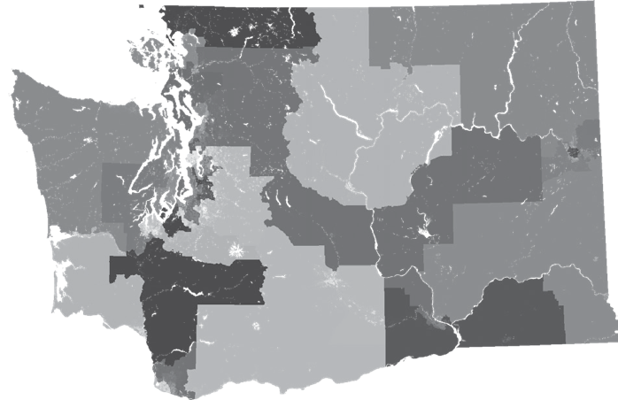
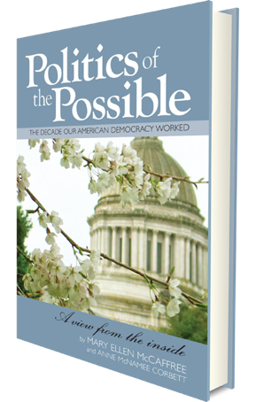
®
Redistricting:
Why it matters
Presented By:
Name of Organizations
May 19, 2019
Notes:
Introduce
Presenter
League Leadership if any in attendance
Elected Officials

Slide 2
League of Women Voters
®
Making Democracy Work
Nonpartisan political organization
Encouraging informed and active participation in government.
Influences public policy through education and advocacy.

Slide 3

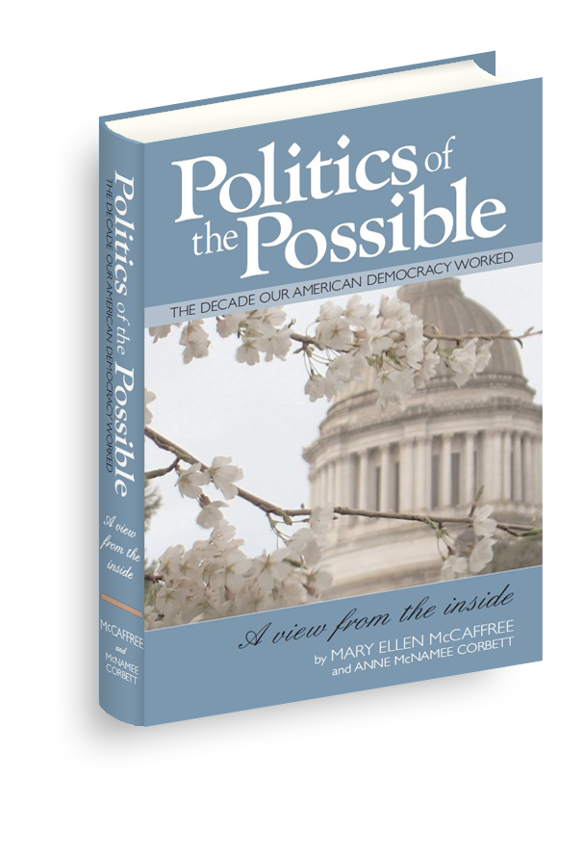
Nonpartisan Nonprofit
  Inspire action through stories of civic engagement
  Enhance civic education
  Create cultural change to honor public service
Director: Alison McCaffree
Notes:
Non-partisan Organization
Increase citizen engagement
Increase civics knowledge
Honor public service
Philosophies of
Mary Ellen McCaffree
Manager: Alison McCaffree
Mechanical Engineer
Business woman
For profits and nonprofits
Startup & high growth

Slide 4

Goals
Understand Basics
Explore Political Power Dynamics
Status of Gerrymandering in Courts
Action Planning
Notes:
Understand basics of Redistricting and Reapportionment processes
Understand the history and importance of redistricting to political power
Action Plan – Discuss what actions you can take to improve our democratic process
Introduction
Definitions
National View
Washington State View
Questions

Slide 5
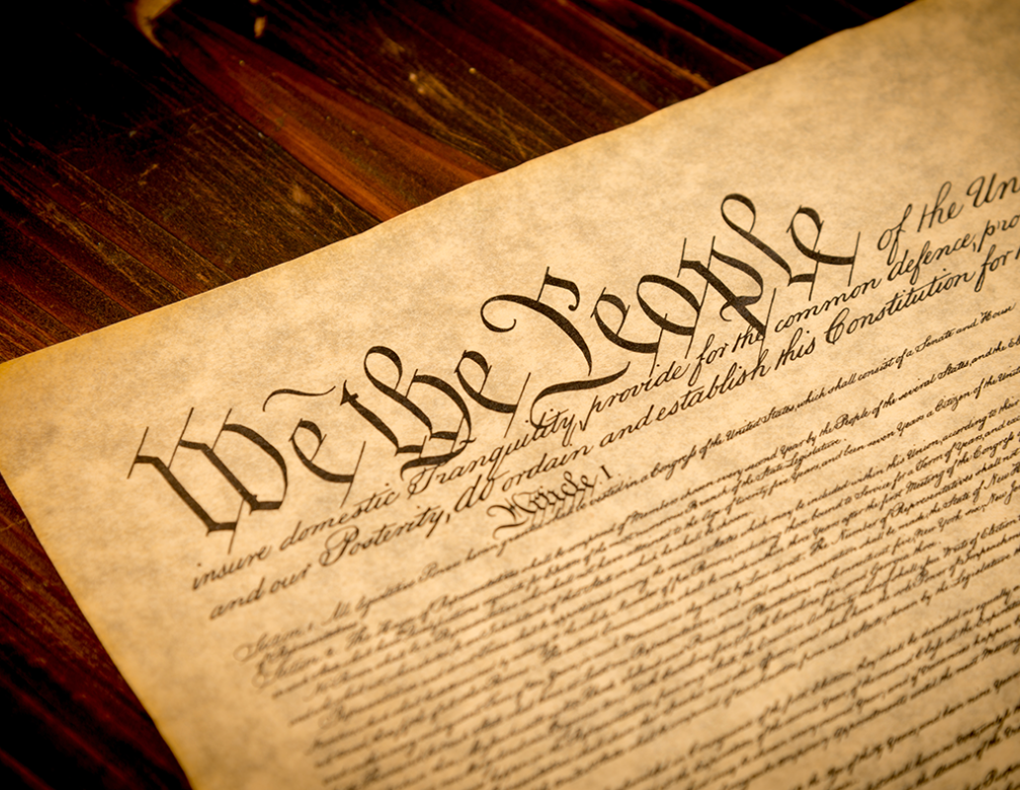
Reapportionment & Redistricting
Fundamental processes that strives for ideal representation and ensure a fair distribution of political power
Notes:
Fundamental processes
Strive for ideal representation
Attempts to ensure a fair
distribution of political power
Constitutional Principles
Representative – one person, one vote
Check and balances – balance states rights and federal responsibility

Slide 6
U. S. Census Bureau
Total Resident Population
“where you live and sleep
most of the time”
Notes:
Includes:
Citizens and non-citizen
Adults and children
Registered and non-registered voters
College students at college
US Armed Forces & federal employees + dependents in their registered home residence.
Prisoners at prison (historically)
Not people in DC, Puerto Rico or Island territories
www.census.gov/population/apportionment/about/faq.html

Slide 7
Why is the Census Important?
Allocates representation
Allocates $675 Billion in federal programs (2015)
Guides research and critical questions
U. S House of Representatives
State Legislative Districts
Local Governments, Schools and Fire Districts
  Estimates say 2020 will be $900 Billion nationally
  Washington State receives $14B federal funds annual
  Businesses
  Nonprofits
  Universities
Notes:
Allocate representation
U. S House of Representatives
State Legislative Districts
Local Governments with Districts
Allocate $675 Billion in federal programs (2015)
Medical Assistance ($311B)
Supplemental Nutrition “SNAP” ($71B)
Medicare Part B ($70B)
Highway Planning and Construction ($38B)
Federal Pell Grant Program ($30B)
Research and Decide Critical Questions
Businesses – Ex: Where does Walmart put its next store?
Nonprofits – Ex: Where to have services
Universities – Population Shifts

Slide 8

Yes.
Illegal – fines not inforced
Cost to send someone out – if don’t return
If you return – No one comes to your door.
Notes:
What is new about the 2020 Census?
Online – postcard and email
Phone
Paper
Census Workers – less then 1% of households will get a “enumerator” showing up at their house. (only if they have’t turned it in yet)
Should people simply not answer the citizenship question if it stays on the form?
Response to the decennial census is required by law. There are penalties for not answering census questions ($100 fine) and for providing false responses ($500 fine). The Census Act also prohibits any action that is intended to cause an inaccurate enumeration ($1,000 fine and/or up to one year imprisonment). The Census Bureau, however, is a statistical agency and does not enforce the law; that responsibility falls to the Department of Justice. As a practical matter, the Census Bureau uses the “carrot approach” to encourage full participation in the census and does not refer cases of nonresponse to DOJ for prosecution.
Puerto Rico
In June 2017, after the pro-statehood party swept into power, Puerto Ricans on the island voted to join the United States as the 51st state. It was the fifth time the island has held a referendum on whether to join the republic. The vast majority voted in favor of statehood: 97 percent — the largest number yet.
The problem is that fewer than a quarter of registered voters turned out to the polls. That was mostly the result of a boycott from the anti-statehood political groups, who were upset with the wording of the referendum.

Slide 9
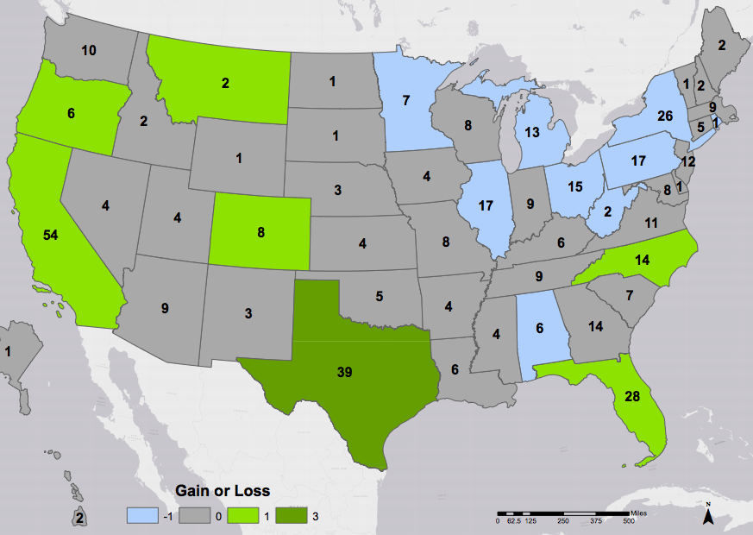

2020 Census in Trouble
Total Budget:
$15.6 Billion
2019:
$3.4 Billion
Notes:
New Census Bureau Director = Dr. Steven Dillingham
Severely underfunded
$15.6 Billion funding needed
Despite a drop in per household cost
$88 per household (2020) vs $124 per household (2010) - (a 29% reduction).
A poorly implemented census will result in already underrepresented communities such as people of color, low income and rural communities receiving less funding for services and being underrepresented in elections.
First the good news.
The spending bill gives the Census Bureau $2.814 billion in the current fiscal year that ends on 30 September. That’s nearly double the president’s 2018 request for the agency and almost $1 billion more than what advocates said it needed in the eighth year of the 10-year cycle to prepare for and conduct the decennial census in April 2020.
Phil Sparks of the Census Project, a nonprofit coalition based in Washington, D.C. “Our assessment is the Bureau now has the minimum resources needed to prepare for its constitutional mandate.”
70% of cost in the last two years
Brennen Center Census Update Nov 2018
There have been some positive budgetary developments recently: Congress has now allocated $2.814 billion for the Census Bureau for FY2018 – a $1.13 billion increase from the Trump Administration’s adjusted FY2018 request of $1.684 billion. The final FY2018 budget includes $50 million in contingency funds to meet unforeseen challenges and directs a rapid ramp-up of the communications and community partnership program to match 2008 levels.
With the budget for 2018 passed, attention has turned to the 2019 budget, where obstacles remain. President Trump has requested $3.8 billion for the Census Bureau, $3.015 billion of which consists of funding for the 2020 Census. The Administration’s proposed funding level is $437 million below the Commerce Department’s revised FY2019 cost estimate of $3.452 billion. In comparison, the Bureau received nearly $4.2 billion in funding in 2009.
Even if the Bureau’s funding matched the Commerce Department’s cost estimate, watchdogs inside and outside the government question whether the estimate is high enough to put the Bureau back on track given the sheer volume of cancelled and suspended tests and the large number of projects that still need development. Many are worried that if the Bureau does not get the funding it needs to complete testing and development on time, it might be forced to use older and more costly methods in 2020. As a result, the Bureau’s funding will remain a point of keen interest for the remainder of this decade.

Slide 10
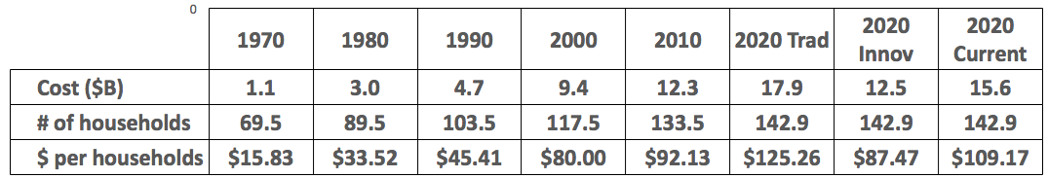
Census
Total
Cost

Slide 11
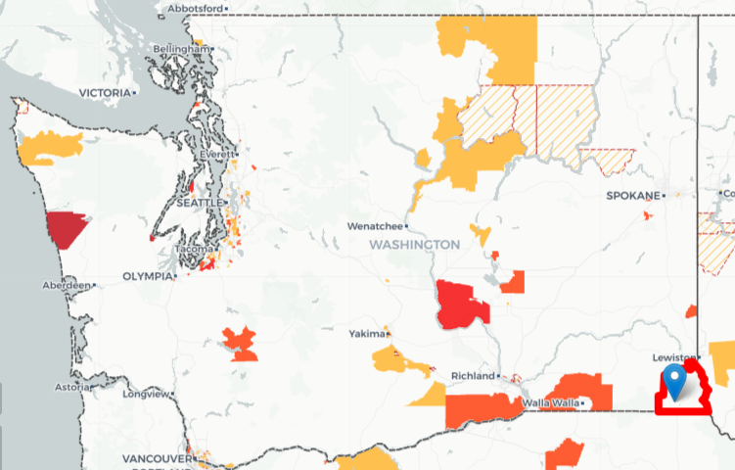

Hard to Count:
Washington

Slide 12
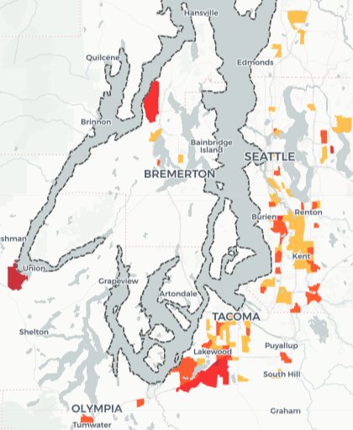
Hard To Count:
Puget Sound

Slide 13
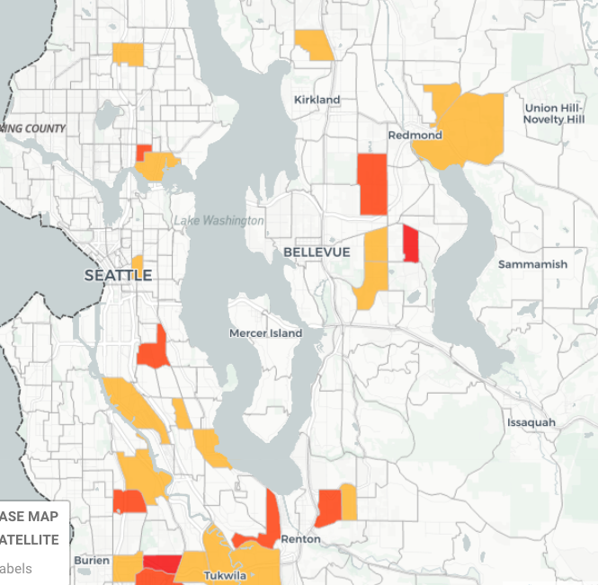
Hard to Count: Seattle

Slide 14
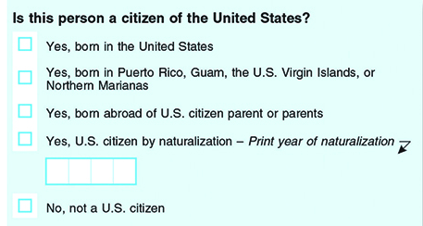
Citizenship Question
The survey does not ask whether noncitizens are legally in the country.
Notes:
The 1950 census form asked where respondents were born and whether they were naturalized.
In 2016, we tested changes to questions on 10 topics,” said Victoria Velkoff, chief for survey of the American Community Survey Office. “This test is a critical step to make the ACS questions current and easy to answer.”
The content test looked at changes to these subjects:
Telephone Service
Computer and Internet Use
Health Insurance
Journey to Work
Weeks Worked
Class of Worker
Industry and Occupation
Retirement Income
Relationship
Race and Hispanic Origin
If approved, the Census Bureau will implement these proposed changes in January 2019. See highlights of the testing and outcome for selected topics in the sections below.
(The Census Bureau is legally required to keep answers confidential, even from the FBI and other government entities. That means it isn't allowed to release data identifying an individual. But federal agencies and researchers can request census information on specific population groups.)
Critical step to make questions current and easy to answer
Experts know question will hurt response & accuracy
17 states, DC 6 cities sueing to block
1950 = The last time ALL U.S. households asked
1070-2000 Short form (1/6)
2010 American Community Survey (3 million households)
2016: tested changes to questions on 10 topics
Current citizenship question not following the process.
Legally required to keep answers confidential

Slide 15
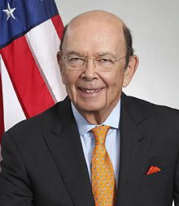
Question in Court
California:
California v Ross
New York:
NY vs Dept of Commerce
Maryland:
Kravits vs Dept of Commerce
All three federal judges:
Violates APA & US Constitution
Ruled for plaintiff & ordered question removed
Appealed to the U.S. Supreme Court
  Oral arguments heard on April 23, 2019
Department of Commerce Secretary
Wilbur Ross
Notes:
Maryland ruling Friday 4/5 – in the news over the weekend.
Administrative Procedures Act (APA)
7+ cases that have bundled into the following 3

Slide 16
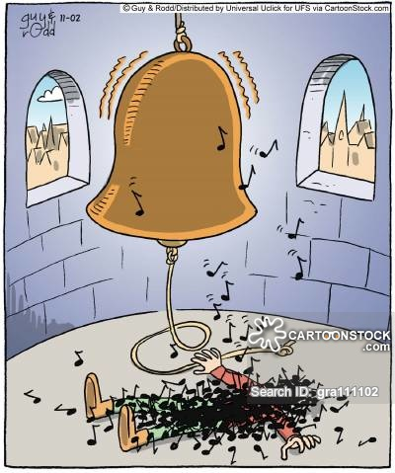
You
Can’t
Unring a Bell

Slide 17
Census
Actions
Funding from State Government
  Encourage CBOs to apply for money
  Fundraise additional money to support outreach & communication
Community Organizing
  Reach out to hard to count communities
  Customize materials
  Hold parties.
  Help at libraries
®

Slide 18
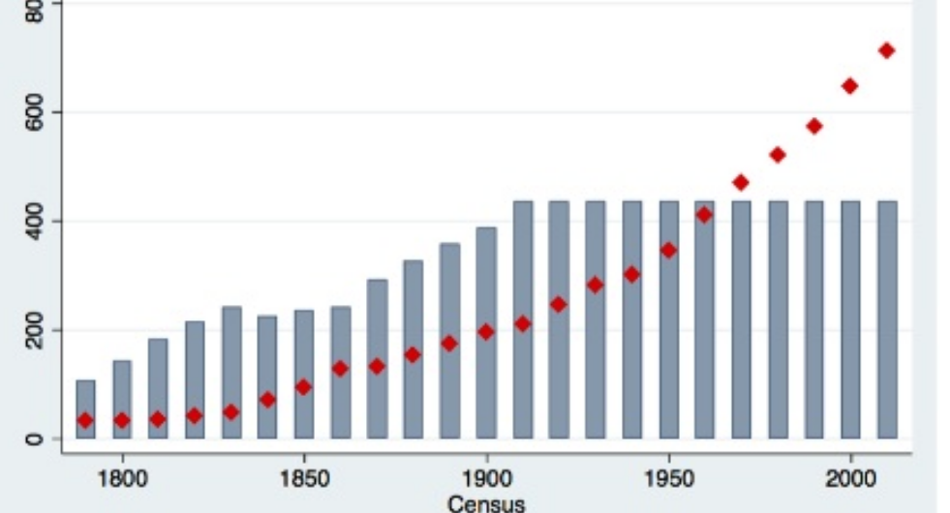
Population in each
U.S. House District
672,454
Notes:
If we kept the original 1:30K – we would have 10,000 members of the house
= 672,454 CDs ---- LD = 137,236
July 1, 2017 Population of Wa state = 7,405,742

Slide 19

Redistricting
Changing the boundaries of districts to reflect the change in population
  Equal population = One person, one vote
Notes:
Changes the boundaries of districts to reflect the change in population
Every district approximately equal population
Everyone’s vote carries the same weight (“one person, one vote”)
Determines the likelihood a political party will win a seat and therefore which party will have control.

Slide 20
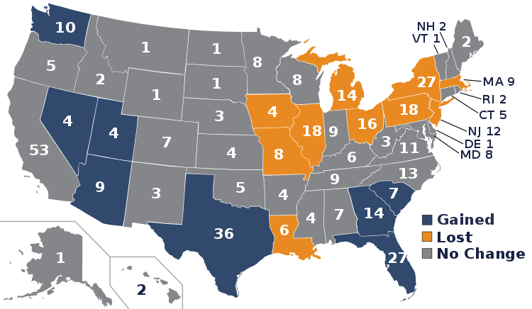
Reapportionment
Changes after 2010 Census
Notes:
U.S. congressional apportionment:
Seats of in the U.S. House of Representatives (435)
Most recent constitutionally mandated decennial census.
In Washington:
Using the census
49 legislative districts
#of people in each
The Apportionment Act of 1911 (Pub.L. 62–5, 37 Stat. 13) was an apportionment bill passed by the United States Congress on August 8, 1911. The law set the number of members of the United States House of Representatives at 435, effective with the 63rd Congress on March 4, 1913.

Slide 21
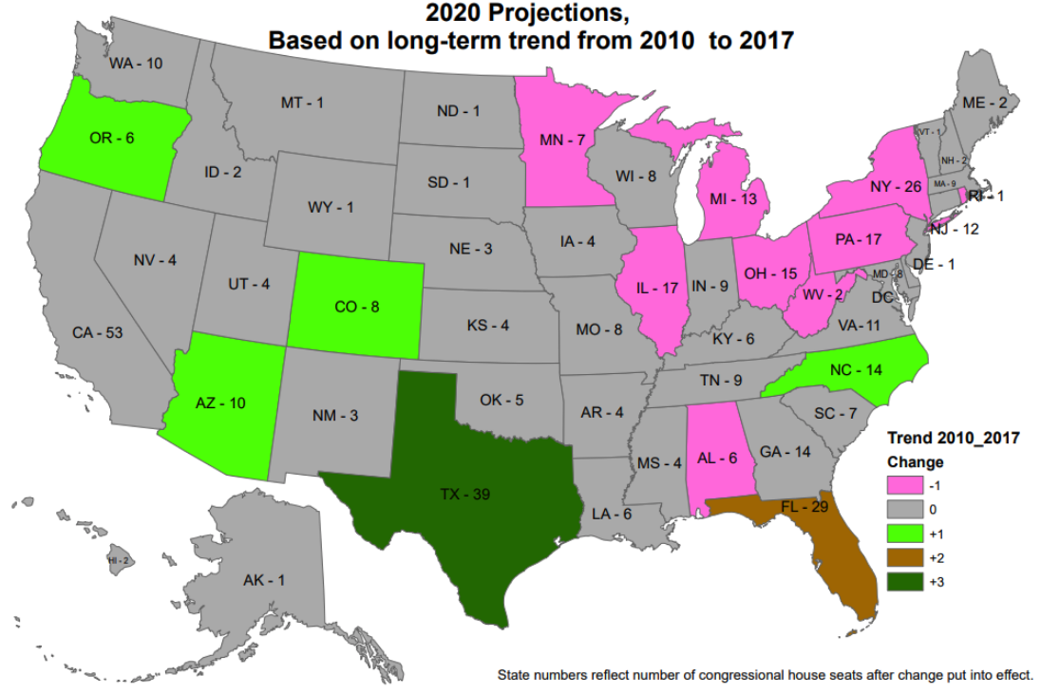
Reapportionment
2020
+1
-1
+3
+2

Slide 22
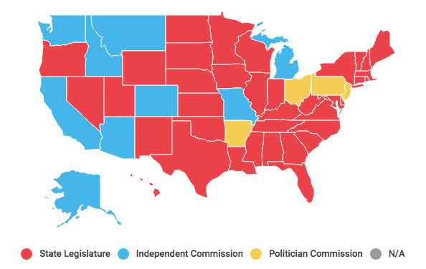
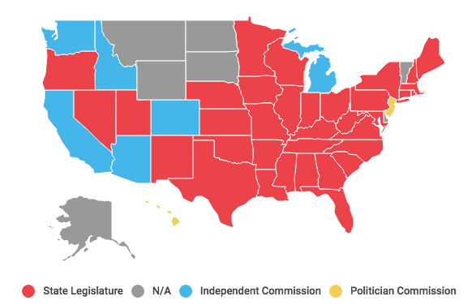
Who Chooses Districts?
Legislative Districts
Congressional Districts
** includes results of 2018 Midterms
Legislature Independent Commission Political Commission N/A
Notes:
Constitution Article I, Section 4 “The times, places and manner of holding elections for Senators and Representatives shall be prescribed in each state by the Legislature thereof, but the congress may at any time by Law make or alter such Regulations, except as to the Places of chusing Senators”
LWV pushing for Commission in WA since 1930, finally in 1983.
Arizona State legislature vs Arizona State Commission
Commission created by initiative
Republicans in Leg sued - saying it was unconstitutional
2017 Federal courts decided commission was constitutional and the maps stand
California also created by Initiative – 2008 to do Legislature and Tax Board, then in 2010 added Congressional.
Others with commission: Washington, Idaho, Montana, Alaska, (independent) Hawaii (political)

Slide 23





2011 WA Redistricting Commission
  No elected officials or party officers in prior two-year period
  No registered lobbyists within the past year
Established by constitutional amendment in 1983.
Members of the 2011 Redistricting Commission
Democrat
Republican
Senate
Non-voting Chair
House
Notes:
Five-member independent commission,
requires 3 of 4 voting members to pass.
Established by constitutional amendment in 1983.
The majority and minority leaders of the Washington State Senate and Washington House each appoint one registered
No elected officials or party officers in prior two-year period
No registered lobbyists within the past year
Commission's chair:
Non-voting member, non-partisan
Appointed by four other commissioners
In the event that the four voting commissioners cannot agree on a chair, the Washington Supreme Court must appoint one.
Legislature has 30 days to amend the commission's maps by a two-thirds vote in each chamber, can only affect less then 2% of district
Chair: Laura Powell – chemist, corporate and federal gov experience, from Tri Cities.
Sen Rep: Slade Gorton – lawyer,, state house representative AG,congress senator
Sen – Dems: Tim Ceis – lawyer, chief of staff position at city and county,
House Rep: Tom Huff – Sears exec – Retail, former House Representative
House Dems: Dean Foster, - chief clerk, gov gardners chief of staff, served on 2001 commission
Douglas Johnson, a redistricting expert and founder of the National Demographics Corporation, says “they’re pretty clearly better than the legislatures have been at taking the politics out.” Though legislatures are loath to cede power, several states have discussed the idea, with Nebraska and Illinois the most likely to switch to a commission, Johnson says.

Slide 24
Washington State
Redistricting Rules
Maintain Equal Population
Compact, contiguous, convenient
Minimize splitting Political Boundaries
  County and municipality
Preserve Communities of Interest
Prohibit Undue Favoritism
  Party or group
  Provide fair and effective representation
  Encourage electoral competition
Notes:
The state constitution requires that congressional and state legislative districts "should be contiguous, compact, and convenient, and follow natural, geographic, artificial, or political subdivision boundaries." The constitution states that the redistricting commission "must not purposely draw plans to favor or discriminate against any political party or group."[14]
State statutes require that congressional and state legislative districts "preserve areas recognized as communities of interest." State statutes also require the commission to draw districts that "provide fair and effective representation" and "encourage electoral competition."[14]
Also in statute – but not discussed here – not relecent at this time.
Nesting is required
Upper chamber district contains two or more intact districts for the lower legislative chamber.

Slide 25
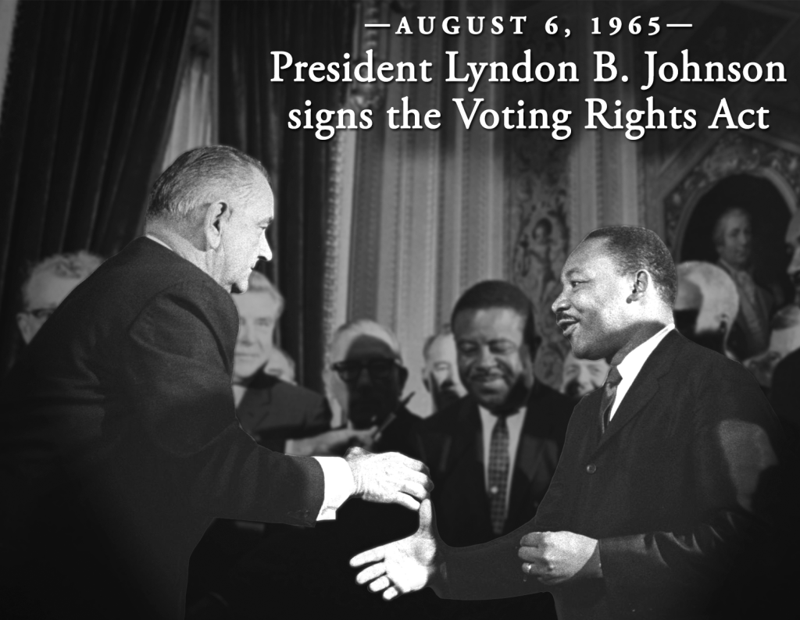
Voting Rights Act 1965
Section 2
Prohibits voting practices or procedures that discriminate
Section 5
Covered jurisdictions
require federal court
approval
Notes:
“ No voting qualification or prerequisite to voting, or standard, practice, or procedure shall be imposed or applied by any State or political subdivision to deny or abridge the right of any citizen of the United States to vote on account of race or color.[5] ”
Designed to combat tactics denying minorities the right to an effective vote, including redistricting
Section 2 - Prohibits voting practices or procedures that discriminate on the basis of race, color, or membership in one of the language minority groups (reconfirmed Mobile v. Bolden, 446 U.S. 55 (1980))
Section 5 - Covered jurisdictions
require federal court approval
before changing any voting laws.
In June 2013 in Shelby v Holder
Section 5 was rendered unusable
because coverage formula in
Section 4(b) was determined to
be unconstitutional.

Slide 26
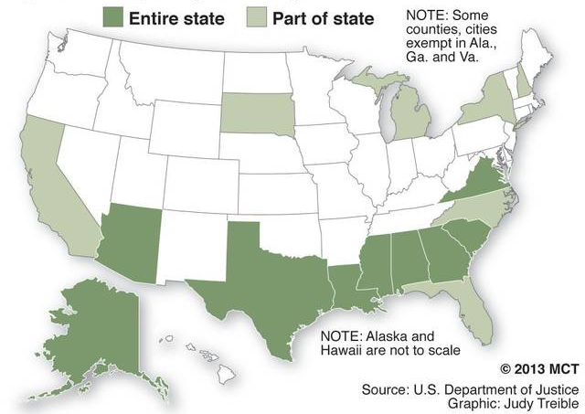
Voting Rights Act
“States with a history of discriminatory voting practices that are subject to Section 5 of the Voting Rights Act; states require federal approval for any changes in voting laws.”
Notes:
US House: HR4 -- will restore the 4b criteria and theirfore restore covered districts.
Shelby v Holder – (June 23, 2013) U.S. Supreme Court ruling eliminated preclearance in VRA, due to outdated 4b criteria
On Sept. 21, 2011, the trial court upheld sections 4(b) and 5 of the Voting Rights Act. The court applied a heightened standard of review -- requiring the preclearance portion of the Act to be "congruent and proportional" to demonstrated constitutional violations. Despite the heightened standard, the court found the preclearance remedy and coverage formula to be congruent and proportional to the constitutional harm demonstrated in the Congressional record established for the provisions' 2006 re-enactment. On appeal, the DC Circuit affirmed. On June 25, 2013, the Supreme Court reversed, finding the formula for determining which jurisdictions must seek preclearance to rely insufficiently on current conditions. With the coverage formula struck down, no jurisdiction will be subject to a preclearance requirement unless and until Congress passes a substitute.
When the Voting Rights Act was passed in 1964, the rampant disenfranchisement of
Black voters was prevalent in the South, thus the coverage formula correctly targeted
jurisdictions for the oversight function of section 5.
Nearly fifty years later, the coverage formula had not changed, after congress passed up on several opportunities to make the formula more current in Voting Rights Act renewal legislation in the eighties and recently in 2006.

Slide 27
Why Controversial?

Slide 28
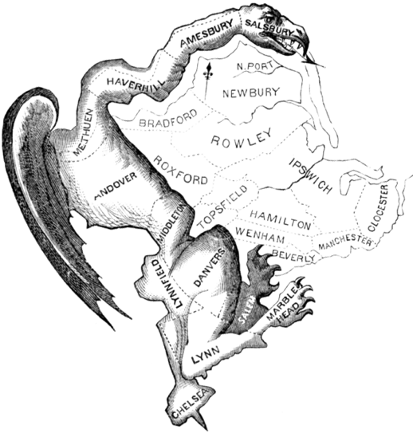
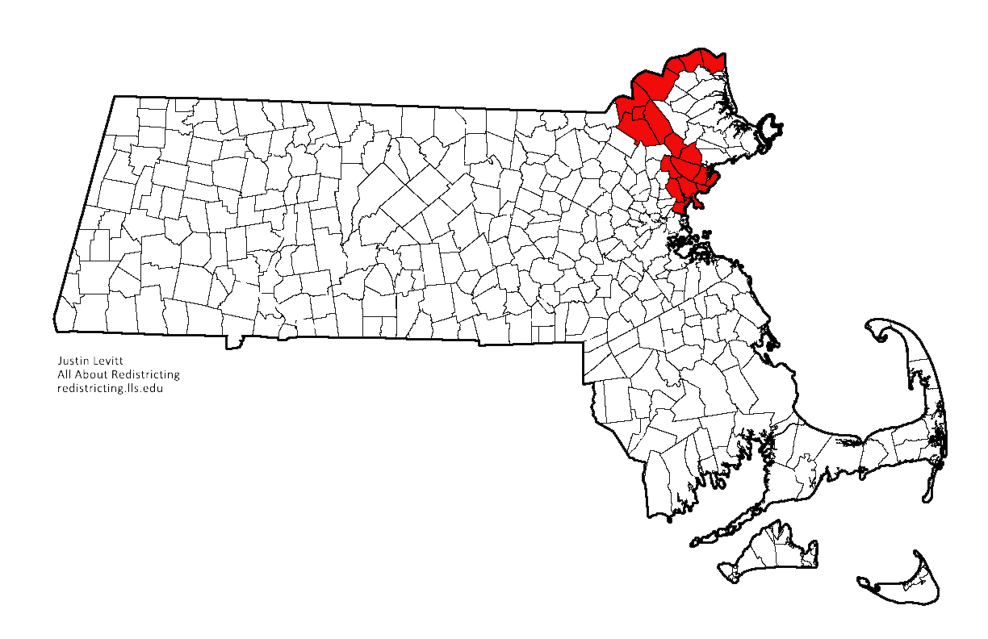
Gerrymandering
Manipulate the boundaries of (an electoral constituency) so as to favor one party or class.
Governor Elbridge Gerry 1812
Notes:
“ unfair”
Printed in March 1812, this political cartoon was drawn in reaction to the newly drawn state senate election district of South Essex created by the Massachusetts legislature to favor the Democratic-Republican Party candidates of Governor Elbridge Gerry over the Federalists.

Slide 29
Gerrymander Tactics
Cracking – spread voters among many districts
Packing – concentrate voters
Tacking – grab a distant area with specific demographics
Hijacking – redraw two districts to force two incumbents run against each other
Kidnapping – put significant support in neighboring district
Notes:
https://en.wikipedia.org/wiki/Gerrymandering#Etymology
"Cracking" involves spreading voters of a particular type among many districts in order to deny them a sufficiently large voting bloc in any particular district. An example would be to split the voters in an urban area among several districts wherein the majority of voters are suburban, on the presumption that the two groups would vote differently, and the suburban voters would be far more likely to get their way in the elections.
"Packing" is to concentrate as many voters of one type into a single electoral district to reduce their influence in other districts. In some cases, this may be done to obtain representation for a community of common interest (such as to create a majority-minority district), rather than to dilute that interest over several districts to a point of ineffectiveness (and, when minority groups are involved, to avoid likely lawsuits charging racial discrimination). When the party controlling the districting process has a statewide majority, packing is usually not necessary to attain partisan advantage; the minority party can generally be "cracked" everywhere. Packing is therefore more likely to be used for partisan advantage when the party controlling the districting process has a statewide minority, because by forfeiting a few districts packed with the opposition, cracking can be used in forming the remaining districts.
"Hijacking" redraws two districts in such a way as to force two incumbents of the same political party to run against each other in one district, ensuring that one of them will be eliminated, while usually leaving the other district to be won by someone from a different political party.
"Kidnapping" aims to move areas where a certain elected official has significant support to another district, making it more difficult to win future elections with a new electorate. This is often employed against politicians who represent multiple urban areas, in which larger cities will be removed from the district in order to make the district more rural.

Slide 30
Hypothetical State
Democrats
40 Republicans
Large City in the middle of the state
Split into 4 districts of 20 people each

Slide 31
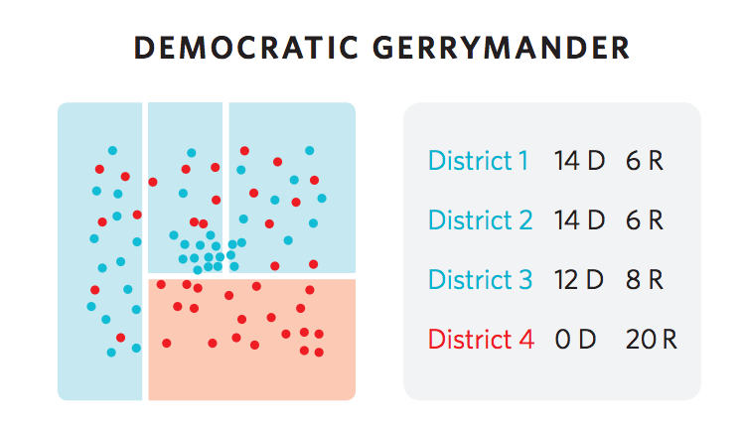
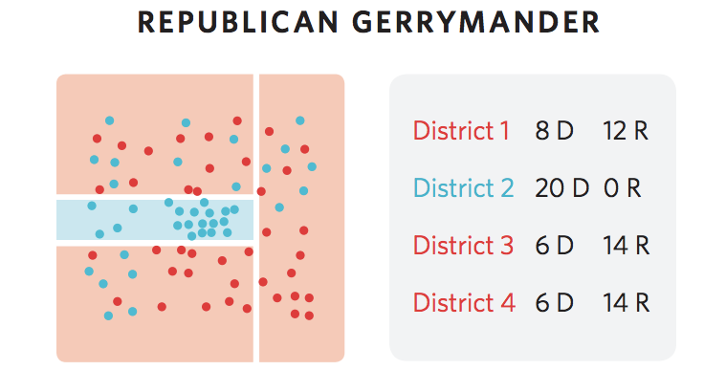
Democratic Gerrymander
Republican Gerrymander
District 1 14D 6R
District 2 14D 6R
District 3 12D 8R
District 4 0D 20R
District 1 8D 12R
District 2 20D 0R
District 3 6D 14R
District 4 6D 14R

Slide 32

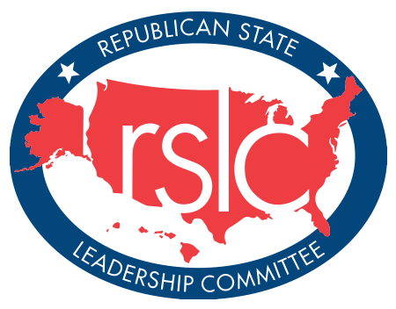
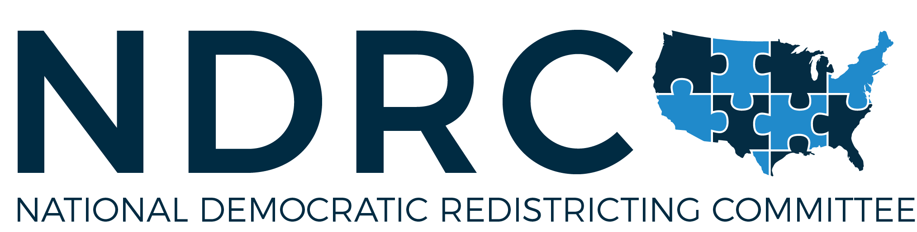
Both Parties Do It!
National Republican
Redistricting Trust
Notes:
HISTORICAL AND TODAY
Democrats
Documented cases in CA, MA, WA pre1955 etc
National Democratic Redistricting Committee, raising money
Feb 2018 announced their state by state strategy
12 states, 9 gubernatorial races, 20 legislative chambers, 2 ballot initiatives, and 2 down-ballot races.
Former President Obama:
redistricting is main politics focus of his post presidency
Raised $10.8M in the first 6 months
Chair: Eric Holder, former U.S. Attorney General
October 2017 sued State of George for partisan gerrymand
Executive Director, Kelly Ward:
Many of the current maps for state legislature and House districts represent Republicans’ “fundamental challenge to our democracy,”
ON Feb 7, 2018, they announced their state by state strategy:
12 states, 9 gubernatorial races, 20 legislative chambers, 2 ballot initiatives, and 2 down-ballot races.
There are 8 additional states on Watch List
Republicans
Republican State Leadership Committee: REDMAP Project 2010
Target State Legislative races in 2010,
Control redistricting in 2011
Results:
Won Majority in U.S. House in 2012 elections
Strong Republican delegation w/ majority Democratic voters: Michigan, Ohio, Pennsylvania and Wisconsin.
Republican State Leadership Committee (RSLC)
Target State Legislative races in 2010
Control redistricting in 2011
Win a Republican U.S. House Majority in 2012 elections
$30 million in 2009-2010
invested $18 million after Labor Day 2010 alone.
Election Day 2010, State Legislative Chambers:
Prior: Democrats 60 Republicans 36.
After: Democrats 40, Republicans 55, and two remained tied.
Strong Republican delegation / majority Democratic voters:
Michigan, Ohio, Pennsylvania and Wisconsin.
2019 NRRT – Scott Walker – notorious Republican Gov from Wisconsin no leading

Slide 33


Big Data & Statistics
Large data sets processed by computer
Computational Models
Notes:
Large data sets processed by computer
Partisan registrations
Census – race, age, occupation, socio-economic status
Preferences – memberships, media, online purchasing
Redistricting Computational Contest Winners
University of Illinois: scalable evolutionary computation model , parallel computing
Princeton University: 3 statistical tests
UNC – Charlotte: statistical methods of mean and median
More powerful tools, more analysis – more fair or more gerrymandered. -- good or more evil.
Frankenstein – technology is not good or bad, its how we use it.
Redistricting Computational Contest Winners
University of Illinois: scalable evolutionary computation model that utilizes high performance parallel computing
Princeton University: 3 statistical tests to reliably assess asymmetry in redistricting: (a) unrepresentative distortion (b) winning vote margins (c) reliable wins as shown in difference between mean and median vote share,
UNC – Charlotte: Adjusted normal partisan vote measures using statistical methods of mean and median
Wendy Cho, a research scientist at the National Center for Supercomputing. During the Tufts conference, Cho described her Parallel Evolutionary Algorithm for Redistricting, or PEAR. The algorithm aims to analyze every possible way to divide a state into districts, then assesses the degree to which a specific map is like the others, or an outlier. This statistical technique is used in many specialties, from breaking cryptographic codes to DNA sequencing.
The number of possible maps is so astronomical that Cho runs PEAR on the Blue Waters supercomputer at the University of Illinois, which can perform 1 quadrillion calculations per second.

Slide 34
1960’s
Pencil & Paper or Typewriter

Slide 35
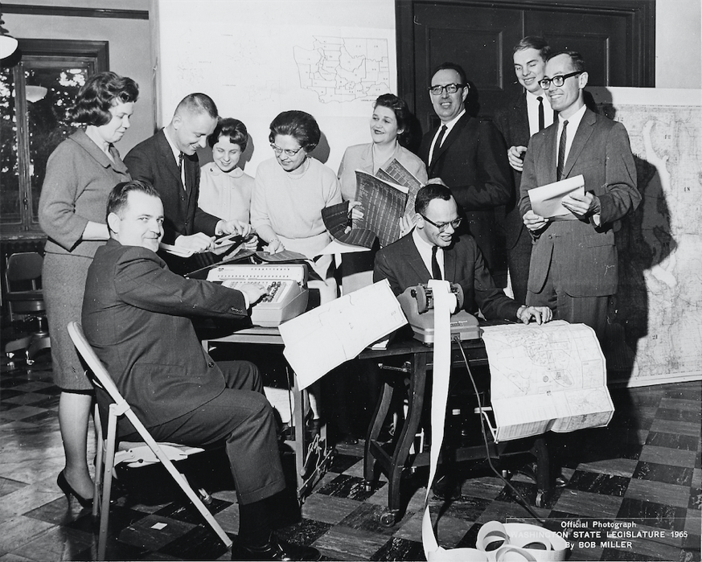
Notes:
Photo of Redistricting team in 1965.
Representative Mary Ellen McCaffree ran the team (far left of picture) and then Representative Slade Gorton (far right) was the Chair of the Elections & Redistricting Committee.
Others in the picture: Ned Lang, Don Moos.

Slide 36

Legislative
Bill Books
1965

Slide 37
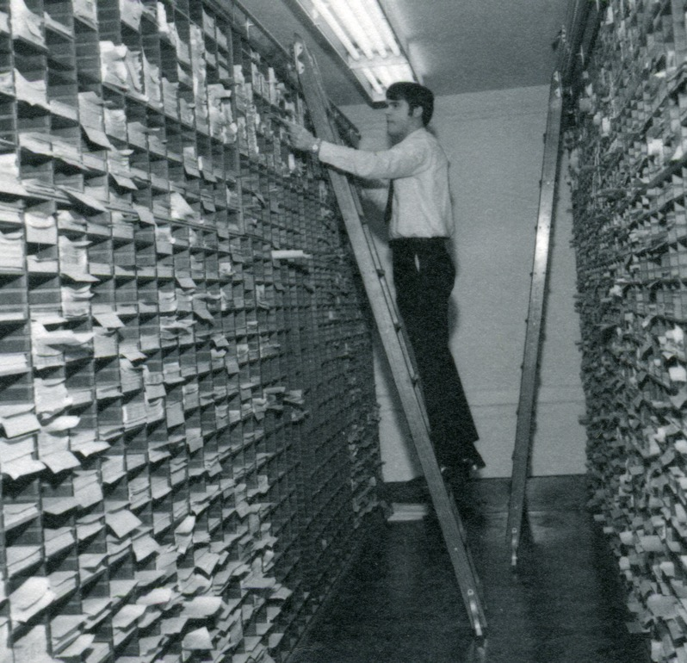

Slide 38
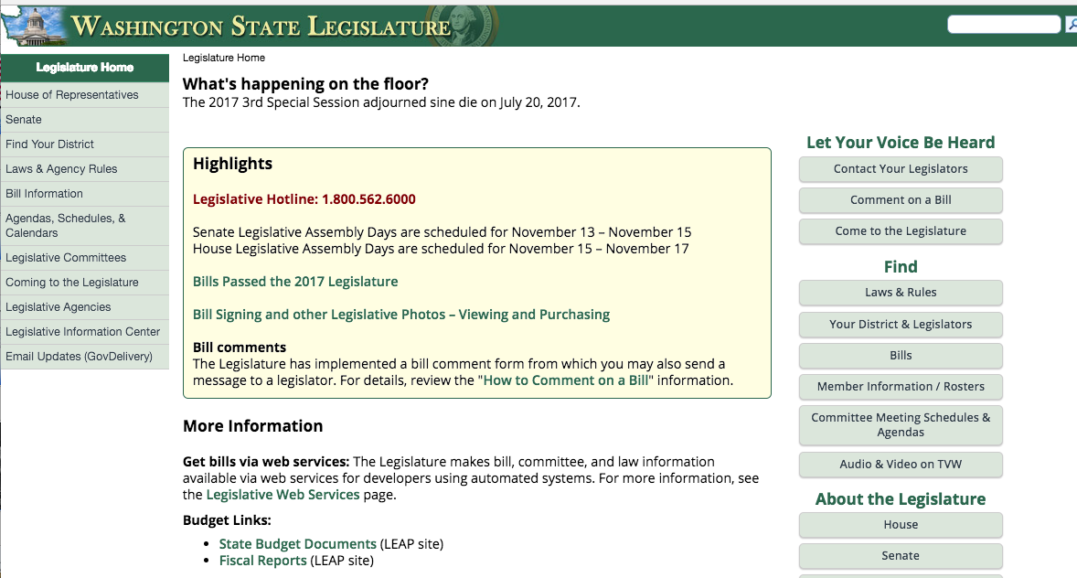

Slide 39

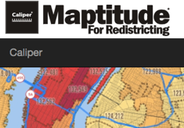



Redistricting Software

Slide 40
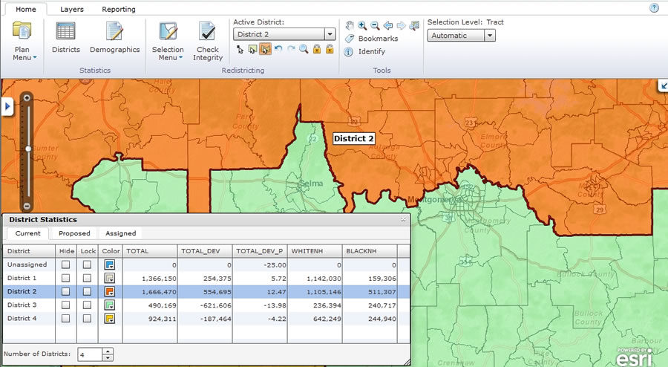
Complex model, quick results
Create, manage, share and maintain redistricting plans

Slide 41

Discussion
What are the pros and cons of modern redistricting vs 1960s?

Slide 42



Redistricting in the Courts
Racial
Gerrymander
Partisan Gerrymander
Prison
Gerrymander

Slide 43
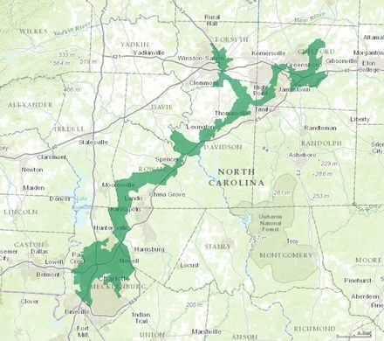
North Carolina Congressional 12th
Notes:
North Carolina's 12th congressional district is predominantly African-American and liberal.
In the supreme court 4 times.
1993 Mel Watt – We will always need minority districts – AA lawmakers – boost minority turn out. More active

Slide 44
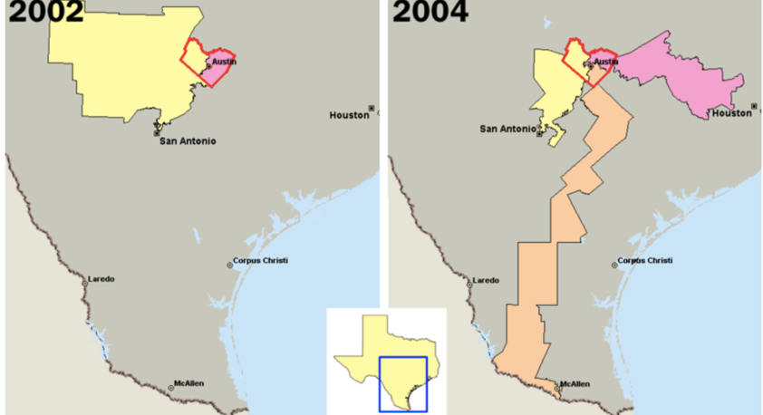
Travis Co, Texas
Notes:
U.S. congressional districts covering Travis County, Texas (outlined in red). In 2003, the majority of Republicans in the Texas legislature redistricted the state, diluting the voting power of the heavily Democratic county by parceling its residents out

Slide 45
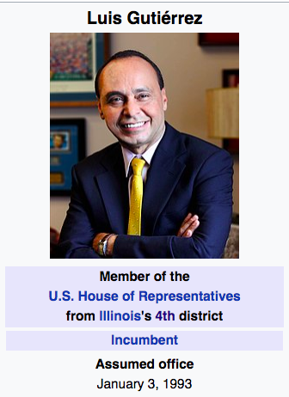
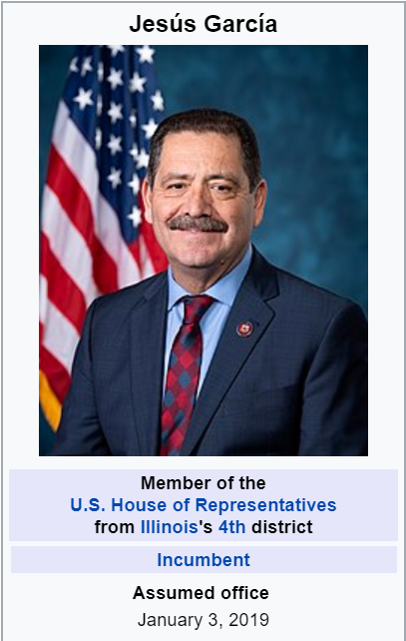
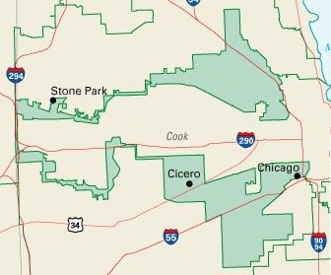
Illinois Congressional District 4
67%
Notes:
Chunks of Pilsen (Mexican American) and Humboldt Park (Puerto Rican) (north earmuff) strung together by a highway
➤ Luis Gutierrez has won 13 straight elections, never less than 75% of the vote, often unopposed ➤ Drawn by civil rights advocates to create a Latino opportunity district fitting together with three majority-Black districts
Accidental packing!
Jesus Garcia is the Democratic member-elect for Illinois' 4th Congressional District in the U.S. House. Garcia won the general election on November 6, 2018, after advancing from the primary on March 20, 2018.
Garcia is the outgoing Democratic District 7 representative on the Cook County Board of Commissioners in Illinois.[1]

Slide 46

Balancing Act on Race
Conscious of race: Minorities can vote a candidate of their choosing – Comply with Voting Rights Act
Not too conscious of race: violate 14th Amendment, Section 2, equal representation by population
Notes:
Chief Justice John Roberts and Justice Antonin Scalia both seemed to indicate that states are in a tough situation when redistricting in that they must take race into account to comply with the requirements of the Voting Rights Act but cannot take race too much into account or else they run afoul of the racial gerrymandering “predominant factor” inquiry. The Chief Justice said that legislatures have to find the “sweet spot” in redistricting.
Note yakima example in WA state
vote dilution challenge under Section 2
need to show that race was the “predominant factor” in redistricting, more important than traditional redistricting principles.
Alabama Legislative Black Caucus v. Alabama
Section 5 of the Voting Rights Act does not require a covered jurisdiction to maintain a particular numerical minority percentage.
Instead, it requires the jurisdiction to maintain a minority’s ability to elect a preferred candidate of choice.
vote dilution under Section 2 of the VRA.
Thornburg v. Gingles, 478 U. S. 30, identifies three threshold
conditions for proving such a vote-dilution claim: (1) A “minority
group” must be “sufficiently large and geographically compact to constitute
a majority” in some reasonably configured legislative district,
id., at 50; (2) the minority group must be “politically cohesive,” id., at
51; and (3) a district’s white majority must “vote[ ] sufficiently as a
bloc” to usually “defeat the minority’s preferred candidate,” ibid.
All three must exist to have a majority-minority district.

Slide 47
Key State Cases - Prisons
New Jersey, Oklahoma, Rhode Island
SCOTUS Dec 2012 – Maryland:
  Fletcher v. Lamone justification for states to reallocate incarcerated persons to their
  home residences
  NEW: Census Bureau Memo of 2/7/18.
    Prisoners will continue to be counted in prison
PRISON GERRYMANDERING PROJECT
www.prisonersofthecensus.org
Notes:
Washington joins California, Delaware, New York, and Maryland as the only states to expressly outlaw prison gerrymandering at the state-wide level, though a few others have measures in place at the local level.
http://www.sentencingproject.org/wp-content/uploads/2015/08/Felony-Disenfranchisement-Primer.pdf
6.1 M people can not vote. 33% are in prison (for felony)(2M) (2016 numbers)
Feb 2018 - 2 million people will be counted in the “wrong” place
77 percent of disenfranchised voters live in their communities, either under probation or parole supervision or having completed their sentence

Slide 48
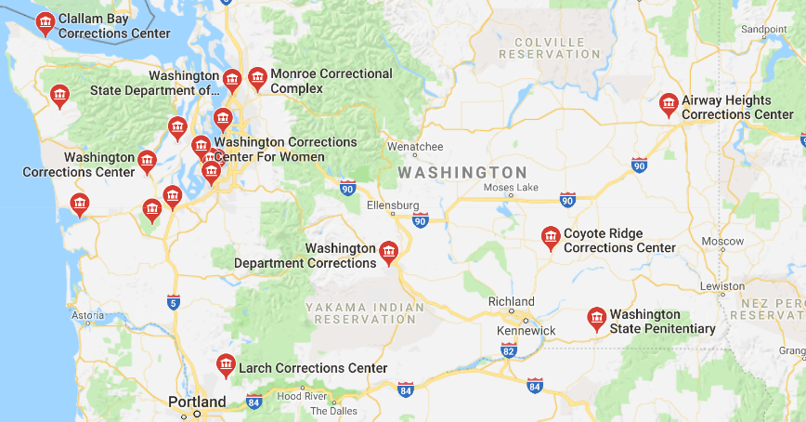
Washington Prisons
SB 5287 passed and became law July 2019
Notes:
2019 Bill - 2SSB 5287 – will address this.

Slide 49
Partisan Gerrymander
Is it Constitutional?
How much is too much?
Notes:
Colegrove v Green 1946 - But courts have traditionally been reluctant to resolve redistricting disputes, heeding Justice Felix Frankfurter's 1946 warning that courts "ought not to enter the political thicket."
Veith v. Jubilirer (2004) partisan gerrymandering claims, SCOTUS found no appropriate judicial solution and would not intervene.
Judges split: 4-1-4. Justice Kennedy being the 1 who said not judical YET.
Evenwel v. Abbott (April, 2016) Upheld districts by total population

Slide 50
What most people think is fair.
Votes
(% voting Republican)
37%
48%
53%
Seats
(% Republican reps)
~ 37%
~ 48%
~ 53%
20%
44%
65%
PROPORTIONALITY!

Slide 51
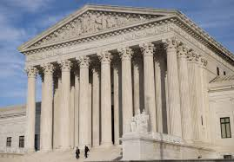
Curb Gerrymandering in Federal Court
2004 Vieth v Jubelirer
Pennsylvania
4-1-4 decision
Political Thicket?
Search for a metric begins.
Notes:
ORAL ARGUMENT - DECEMBER 10, 2003
OPINION ANNOUNCEMENT - APRIL 28, 2004

Slide 52
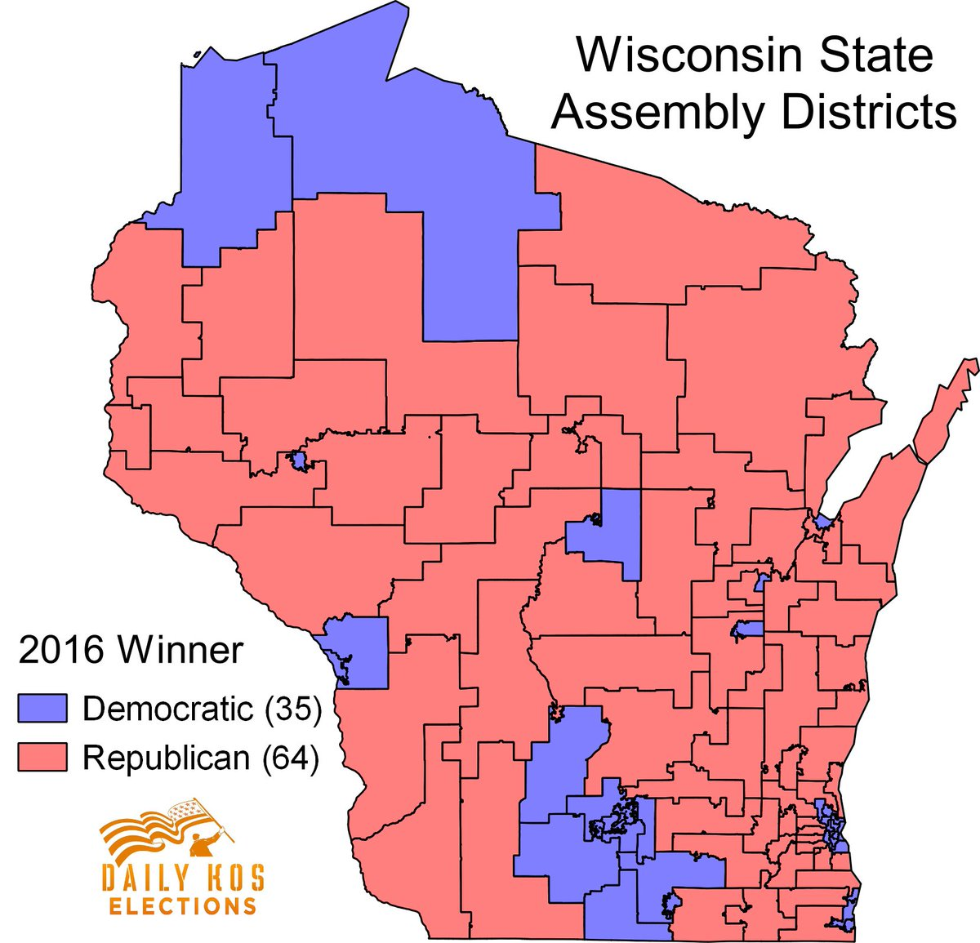
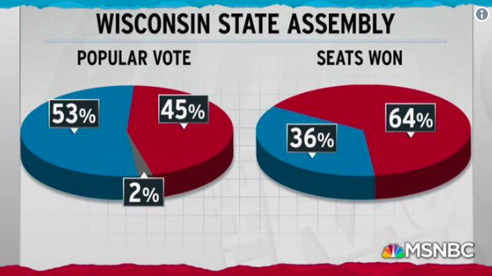
Wisconsin Assembly
2018 Winners
Notes:
Whitford v Gill Decision:
. Instead, we acknowledge that the expert opinions in this case have persuaded us that, on the facts before us, the EG is
corroborative evidence of an aggressive partisan gerrymander that was both intended and likely to persist for the life of the plan.
At a statewide level, Wisconsin is a quintessential battleground where races are often decided by only a few percentage points. Contrast that to the state assembly map the Republicans drew: In 2012, they won 60 of the 99 seats in the Wisconsin Assembly despite winning only 48.6% of the two-party state-wide vote; in 2014, they won 63 (64%) seats with only 52% of the state-wide vote.
Partisan composition
PartyAs of February 2018
Democratic Party 35 - 35%
Republican Party 62 - 62%
Vacancies2 Total 99
2016 Presidential election
Clinton – 46.5%
Trump – 47.2%
1) Milwaukee city 594,833
2) Madison city 233,209
3) Green Bay city 104,057
4) Kenosha city 99,218
5) Racine city 78,860
6) Appleton city 72,623

Slide 53
#1) Statistical Advantage
Political party’s voters tend to cluster in different districts.
  Democratic voters live in cities like Madison & Milwaukee.
  Republicans tend to be more rural.
Statistical advantage (median-mean comparison)
  UNC-Charlotte study
Natural Sorting
Democrat Bias
1.1
3.9
Republican Bias
Current Maps
3.8
6.3
0
unbiased
Notes:
These neutral maps show a natural gerrymander of 1.1 to 3.9 percentage points favoring the Republicans.
Total bias of 3.8 to 6.3 percentage points in the current map.
Whitford v Gill – Federal Court Decision
Having carefully examined the evidence bearing on this issue, we find that substantial portions of the record indicate, at least circumstantially, that Wisconsin’s
political geography affords Republicans a modest natural advantage in districting. Indeed, the plaintiffs conceded as much in their closing argument when counsel stated that “there likely is some natural packing” of Democratic voters, “especially of minority voters in places like Milwaukee.”
Even the Demonstration plan with as low an EG as professor could make – had a slight Republican advantage 2.2%.
Because the evidence at trial establishes that Wisconsin has a modestly pro-Republican political geography, we now examine whether this inherent advantage
explains Act 43’s partisan effect. We conclude that it does not.

Slide 54
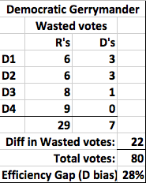
#2) EG = Efficiency Gap
Number of votes “wasted”
Subtract: Wasted Votes from each party
% = Difference in Wasted Votes / Total Votes
11 votes = WIN
Notes:
McGee – basically a measure of vote dilution
October 3 2017 – SCOTUS
Standing - Kennedy suggested that the question should be decided based on the First Amendment guaranteeing freedom of association and not the Fourteenth Amendment regarding equal protection, which has been evoked in other gerrymandering cases.
Is efficiency gap a robust enough measure – people understand: too new, too hard to understand, not robust to uncontested cases
cast for the losing candidate
victorious candidate did not need
What are the consequences if they do nothing
Kennedy’s vote will be determined on
how well plaintiffs prove gerrymandering,
what standards the court will use to judge district lines and
how big a role Kennedy believes the court should play a role in dictating legislative maps, political science professor Ryan Owens – Univ of Wisconsin, Madison
Whitford is a former UoW professor, that gathered (Democrat) living in Madison – gather when lawyers were putting together a lawsuit with EG at its core.
if the Supreme Court sets guidelines to prohibit partisanship from being used to draw district lines, it would put “10 to 12 more chambers in immediate play” in six or seven states, said Jessica Post, the executive director of the Democratic Legislative Campaign Committee.
Thursday, October 26, 2017By Ciara Torres-Spelliscy, Brennan Center for Justice | Op-Ed: I signed an amicus brief in Gill with 11 other constitutional and election law scholars arguing that the Wisconsin map violated the First Amendment. The argument was based on the First Amendment's right of free association. Not only does someone have the right to join with others to exercise political influence, such as joining a political party, but a person has the right not to be discriminated against because of their tie to that organization. I was in good company in trying to persuade the court. More than 50 amicus briefs have been filed in the case. The reason everyone wants to get a word in is because Gill c

Slide 55
Efficiency Gap in WA
Washington State Congressional Districts Efficiency Gap by Decade

Slide 56
Efficiency Gap in WA
Washington State Legislative Districts Efficiency Gap by Decade
←Republican Bias
Democratic Bias →

Slide 57
#3) Map Outlier Analysis*
Map passed into law
* approximation

Slide 58
Discussion
Partisan Gerrymandering is…
5
4
3
2
1
0
“Clearly Unconstitutional”
Use measures to show how much is too much.
“Political Thicket”
A result of politics. The courts should not weigh in

Slide 59

Gill v Whitford
(Wisconsin)
2018, June
9-0 decision
No standing for Democrats
Notes:
ORAL ARGUMENT - DECEMBER 10, 2003
OPINION ANNOUNCEMENT - APRIL 28, 2004

Slide 60
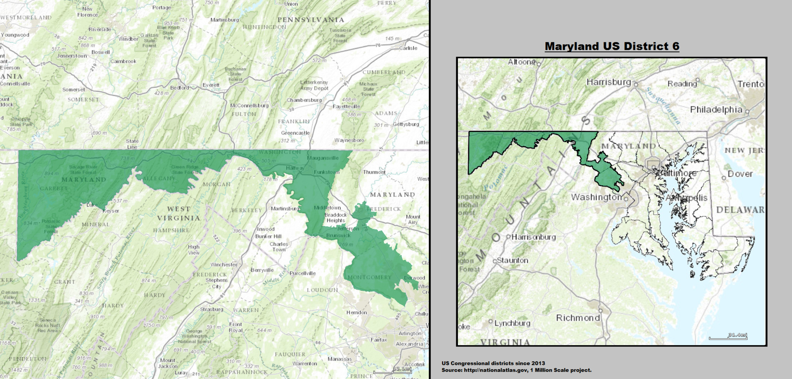
Maryland 6th Congressional
U.S. Supreme Court
Benisek v Lamone
Delegation = 7D:1R
Notes:
Benisek v. Lamone – March 26th.
Oral Arguments Tuesday 3/26/19 – Delegation= 7D:1R
2018 elected a Republican Governor 55% (Larry Hogan(R) over Ben Jealous (D)
Intent – document evidence that this is what the Democrats were doing.
Safe Republican Seat. Then in the last round 2011 – the districts near DC got added making it “competitive” – Democrats have won all three times.
How much is too much – how do we tell?
No decision on gerrymandering
On June 18, the SCOTUS affirmed the district court's decision not to enjoin the map.
Waited too long to seek an injunction
RESULT:
2018 Elections will proceed with existing maps.
Reform advocates wait until 2021 maps

Slide 61
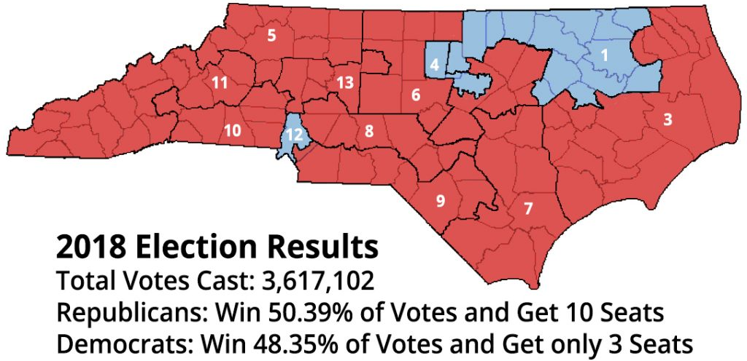
N.C. Lopsided Election Results
Photo credit: Adapted from whowhatwhy.org from North Carolina / WikiMedia

Slide 62
No Federal Court
Remedy
2019
Rucho v Common Cause (NC)
Benisek v Lamone (Maryland)
5-4 decision
Notes:
ORAL ARGUMENT - DECEMBER 10, 2003
OPINION ANNOUNCEMENT - APRIL 28, 2004

Slide 63

State Constitution
“… provide fair
and effective representation…”
Notes:
Since there can be no remedy for partisan gerrymandering in the federal courts, we must rely on state constitutions and the state courts to throw out bias maps.

Slide 64
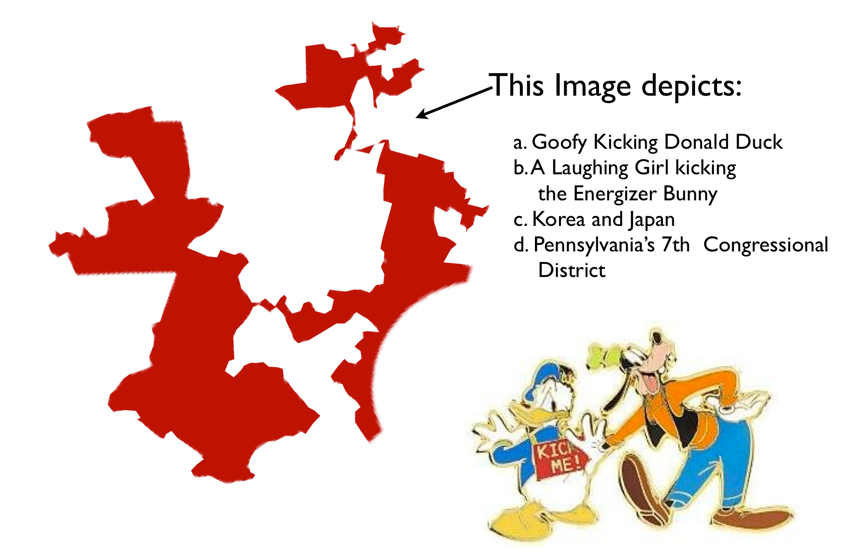
Penn 7th CD (2012 – 2018)

Slide 65
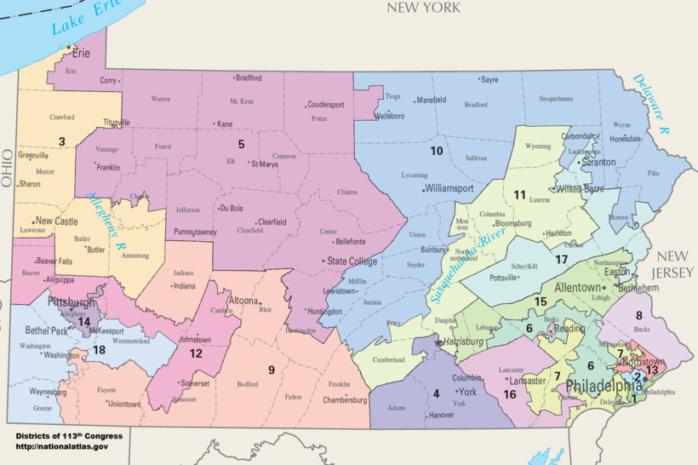
Pennsylvania
Jan 2018 - Penn. Supreme Court ordered maps to be redrawn based on Republican gerrymander
Republican appeal to SCOTUS threatened states rights to protect the State Constitution
Feb 2018 – SCOTUS blocked appeal and redrawing maps proceeded.
13 R / 5 D
Notes:
Article 2/11/18
EASTERN PENNSYLVANIA
A particularly contorted district — Republican Rep. Pat Meehan's 7th District, labeled “Goofy Kicking Donald Duck” — faces an overhaul, perhaps by packing tendrils now snaking through five counties closer to its longtime anchor of Delaware County.
Several other districts could become more compact:
— Democratic Rep. Matt Cartwright's 17th District reaches into six different counties to string together Democratic voters in northeastern Pennsylvania cities.
— Republican Rep. Ryan Costello's 6th District curves through four counties.
— Republican Rep. Lou Barletta's 11th District was sent plunging an extra 75 miles into south-central Pennsylvania from its longtime home in northeastern Pennsylvania.
— Republican Rep. Charlie Dent's 15th District, for decades in the Lehigh Valley, now stretches west 80 miles across five counties.
Meehan, Dent and Barletta aren't running for another term.
WESTERN PENNSYLVANIA
Democratic Rep. Mike Doyle's Pittsburgh-centered district is the only western Pennsylvania seat held by his party. Under a new map, that could change. Doyle's district is heavy with registered Democrats, and shifting some of those voters to districts that share Pittsburgh's suburbs — the 18th District, which is vacant after Republican Rep. Tim Murphy resigned in a scandal, or Republican Rep. Keith Rothfus' 12th District — could make all three districts more competitive.
The 12th District could become more compact. It now runs some 100 miles from the Ohio border past Johnstown in a shape the Pittsburgh Post-Gazette called “a malnourished hammerhead shark winding through six counties.”

Slide 66
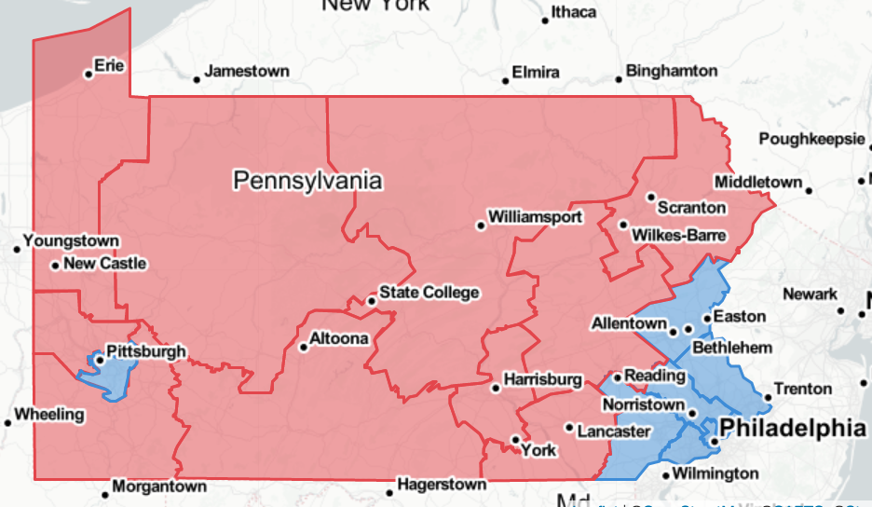
2/19/18 Districts Accepted By Pennsylvania Supreme Court
PlanScore Rating:
Efficiency Gap of 1.9% bias to Republicans
Resulted in 9 Republican and 9 Democratic Districts
Notes:
https://planscore.org/plan.html?20180219T202039.596761160Z
New York Times article:
The new Pennsylvania map released Monday meets every standard nonpartisan criteria. It’s compact, minimizes county or municipal splits and preserves communities of interest. But it consistently makes subtle choices that suggest that partisan balance may have been an important consideration.
League of PA statement
3/20/2018
Harrisburg, PA - The League of Women Voters of Pennsylvania president, Susan Carty, issued the following statement on the Supreme Court decision refusing to block the redrawing of Pennsylvania's congressional districts:
"This victory is for the voters. The League brought this lawsuit to ensure that Pennsylvanians’ votes were not diluted by the unconstitutional extreme partisan gerrymandering of our congressional districts and now, voters will be voting in new, fairer congressional districts in this upcoming election. Voters deserve the right for their voices to be heard regardless of party affiliation or address. This victory is an important first step toward slaying the gerrymander.
"With today’s decision, voters can focus on educating themselves on the candidates and issues on their ballot while making sure they are registered and plan to vote on May 15.
"We celebrate this success, but we know that it is not enough. Unless we can change how we draw both our legislative and congressional maps, we will be right back here in a few years. That’s why we continue to fight alongside many organizations, policymakers and individuals from both sides of the aisle to pass legislation to implement an independent redistricting process."
###
Contact: Suzanne Almeida | 717-234-1576 X 1 | salmeida@palwv.org

Slide 67
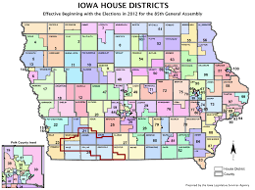
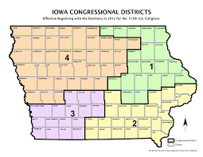
Iowa Districts

Slide 68

Pure Math Districts
Notes:
Shortest straight line.
http://rangevoting.org/
May work for iowa or colorado
Note: port townsend is part of yellow
Tri-cities is split?

Slide 69
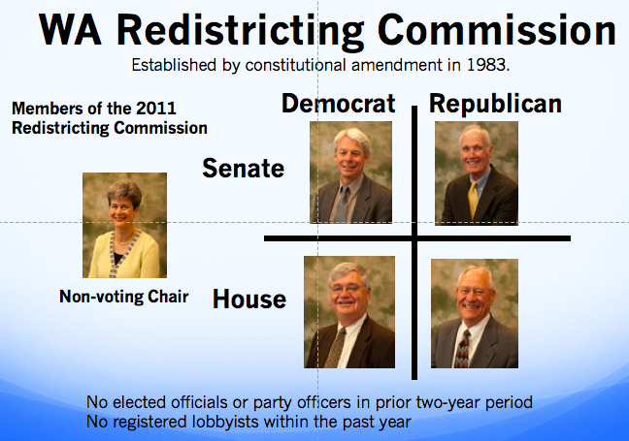
2020 REFORM BILLS
Bill #1
Increase Effectiveness, Transparency
and Accountability
Bill #2
Create a
Citizen Commission

Slide 70

California Commission
14 members
  5 Democrats
  5 Republicans
  4 Unaffiliated
Decides:
  Legislative Districts (40 – Senate, 80 - Assembly),
  Congressional Districts (53) and
  Board of Equalization – CA tax commission(4)
Complex Process for selections
Notes:
California Citizens Commission
14 members
5 Majority Party (Democrat)
5 Minority Party (“second most popular” Republican)
4 non-affiliated
Decides Legislative Districts (40), Congressional Districts (53) and Board of Equalization – CA tax commission (4)
Process for selections
State Auditor collected 5,000 completed applications ( 35K appied, 5k qualified)
3 Auditors selected 20 for each pool.
Majority and Minority Party in each house selected 12 for each pool
Auditor pulled 8 commissioners randomly - (3,3,2)
First 8 commissioners pick the the remaining 6 - (2,2,2)

Slide 71





2031 Commission
  No elected officials or party officers in prior two-year period
  No registered lobbyists within the past year
Proposed Structure
Senate
House
Citizen
Unaffiliated - Citizens
Democrat
Republican
Non-voting Chair
Require Bi-Partisan Simple Majority
Notes:
Citizen selection process run by OSOS.

Slide 72
Redistricting
Actions
®
1) Support Redistricting Reform Bills
2) Complete Census – April 2020
3) Assist Others to Complete Census
4) Vote – Nov 2019, Nov 2020
5) Testify at Commission – June 2021

Slide 73
Discussion
What actions will you take?
Additional questions?
Notes:
What criteria would you use? to ensure that districts fairly represent the people of our state?
How would you like to see Washington State’s districts defined differently?
What other actions can we take to insure a fair and transparent redistricting process?

Slide 74
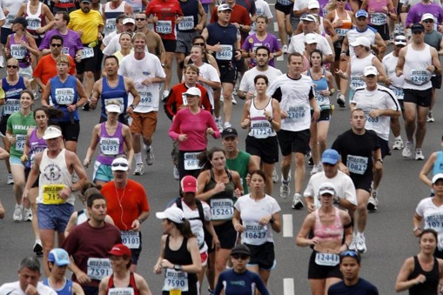
Government only works …
…if we participate.

Slide 75

Contact ME
Presenter Contact information here.
Local LWV League Information

Slide 76
Back Up Slides

Slide 77

COUNTDOWN
2017-2021
Educate & Engage
2020 – Jan - Mar
Support Redistricting Reform Bills
2020 - April
Publicize & Volunteer for Census
2021 - June
Testify. Create Maps.
Notes:
Now (2015-20) – Census Bureau Planning Committee for 2020
2017-19 – Budget appropriations for Census work
April 1, 2020 – Census conducted
December 31, 2020 – official numbers sent to Office of the President
Jan 25, 2021– Clerk of US House informs states of their apportionment
Feb – Mar 2021 – Data from Census Bureau released
May 2021 – Municipalities are informed of their populations
Nov 2021 – Redistricting Committee Map Deadline
January 2022 – Municipality must submit district plans – public has 15 days to contest (same principals as state)

Slide 78
References
Politics of the Possible by Mary Ellen McCaffree Politicsofthepossible.com
redistricting.lls.edu
www.brennancenter.org/issues/redistricting
The Brennan Center supports reforming the redistricting process so that it is independent, transparent, and ensures that communities are fully and fairly represented in Congress and the nation’s legislative bodies.
ballotpedia.org/Redistricting_in_Florida
http://app.leg.wa.gov/oralhistory/redistricting2
origins.osu.edu/article/re-mapping-american-politics-redistricting-revolution-fifty-years-later
www.redistricting.wa.gov

Slide 79

Who is the Census Bureau?
Formed: July 1, 1902; 116 years ago
Headquarters: Suitland, Maryland, U.S.
Employees: 4,285 (2018)
Annual budgets:
  US$1.5 billion (2017)
  US$1.5 billion (2018)
  US$3.8 billion (est. 2019)
Agency executives:
  Ron Dillingham, Director
  Enrique Lamas, Acting Deputy Director
Parent agency: Department of Commerce
Website: www.census.gov

Slide 80
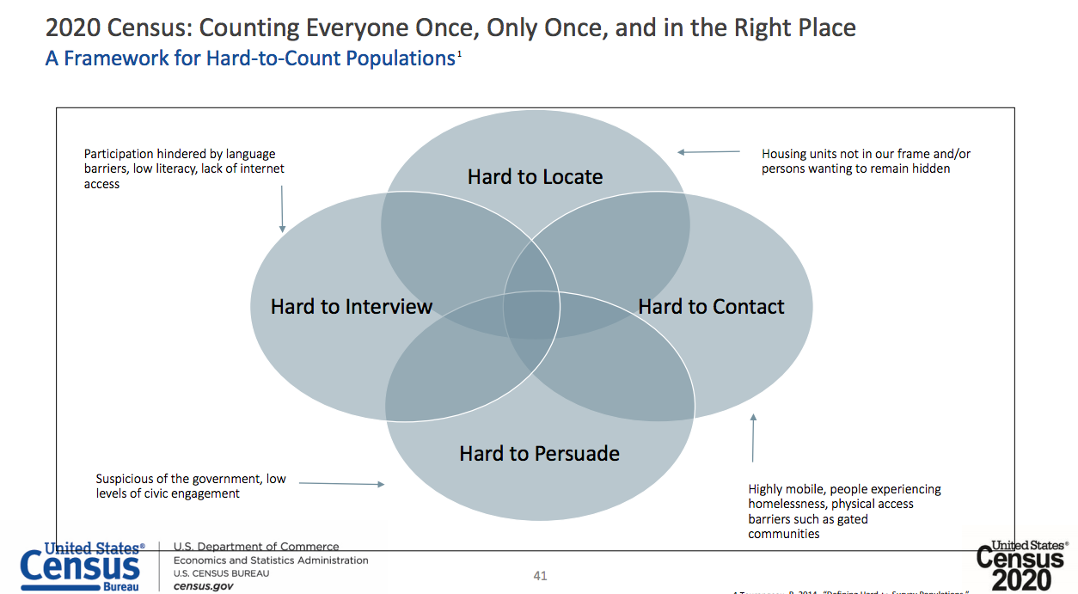
Framework for Hard-to-Count

Slide 81
Who is Hard to Count?
Young children
Highly mobile persons
Racial and ethnic minorities
Undocumented immigrants
Persons who distrust the government
LGBTQ+ persons
Non-English speakers
Low income persons
Persons experiencing homelessness
Person who do not live in traditional housing
Person with mental or physical disabilities

Slide 82

2018 End-to-End Test
All system deployed and integrated effectively
Address update response 95% (local governments)
Good response rate
  Self Response = 52.3%
  Without advertising campaigns
Secure: 1000s of cyber attacks a day – none breached
Tested Post Enumeration Study (since 1990)
Notes:
Success
All system deployed and integrated effectively
Address update response 95% (local governments)
Good response rate
Self Response = 52.3% (Goal was 50%)
Without advertising campaigns
Secure: 1000s of cyber attacks a day – none breached
Post Enumeration Study (since 1990)

Slide 83

Impact in Washington
Regional Offices
2010 = 9
2020 = 5
    Budgeted Census Workers
    2010 = 3,800
    2020 = ???
Cancelled End-to-End Test in Pierce Co
Notes:
Washington State impact
Census field offices: 9 (2010) to 5 (2020)
Community outreach specialists
3,800 (2010) to 43 (2020); a reduction of 98.9%.
Plus Citizenship Question

Slide 84
Complete Count Committees

Slide 85


How concerned that Census will be used against you?
39%
34%
20%
No English
English
Not US Born
US Born

Slide 86

Likely to Respond BY AGE

Slide 87

WA Legislative Districts
Notes:
OneAmerica spokesperson Charlie McAteer has pointed out that while the 15th district now has a majority Latino population, it does not yet have a majority of Latino voters since the count includes people under 18, undocumented immigrants, and permanent residents.
There are now four so-called "majority minority" districts in Washington. The other three -- the 11th, 33rd and 37th -- are all in south King County.
four majority-minority legislative districts – the 15th in Yakima County and the 11th, 33rd and 37th in south King County

Slide 88

WA Congressional Districts
Notes:
Washington State’s first majority-minority congressional district - District 9
Washington
District 9
11.7% - Hispanic
49.1% - White
11%- Black
0.6% - Native American
21.2% - Asian
1.2% - Pacific Islander
0.3% - Other
5% - Multiple Races
Source: United States Census Bureau, "2009-2013 American Community Survey 5-Year Estimates," accessed April 8, 2015
https://ballotpedia.org/Majority-minority_districts
As of 2013, the United States was home to 113 congressional majority-minority districts. This represented approximately 26 percent of the nation's 435 House districts. 18 are held by Republicans, the rest are held by Democrats.

Slide 89


Winner’s Bonus
Notes:
Our electoral system (geographic single-member districts) has a built-in “winner’s bonus”: the party that wins the election gets more than its proportional share of votes.

Slide 90


Massachusetts Example
Where voters live – matters.
30% Republicans
0% Republican Congressional Reps

Slide 91

Michigan Gerrymander?
U.S. House Delegation 2016:
9 Republicans
5 Democrats
U.S. Senate Race 2016:
James (R) = 45%
Stabenow (D) = 52%
U.S. President 2016:
Trump (R) = 47.5%
Clinton (D) = 47.3%
LWV of Michigan v. Benson
Notes:
April 25th 2019
The “predominate purpose” of the redistricting plan approved by the Michigan Legislature in 2011 “was to subordinate the interests of Democratic voters and entrench Republicans in power,” said the unanimous decision written by U.S. Circuit Judge Eric Clay, an appointee of Democratic President Bill Clinton.
Michigan Secretary of State Benson's
On April 25, 2019, the court struck down the challenged districts and ordered the legislature to draw remedial maps for the congressional, state senate, and state senate elections. The court also ordered that special elections be held in 2020 for any state senate districts either enjoined by the decision or modified by the remedial plan.
Must redraw and call new elections in 9 of 14 congressional seats and 25 of 148 legislative districts.
Trump won Michigan by 10,704 notes
New political maps could give Democrats a narrow chance next year to flip control of the House and Senate, where Republicans currently enjoy six-seat advantages. But they would only apply to 2020 because a new voter-approved independent citizen commission will draw new districts in future election cycles.

Slide 92

Michigan Packing?

Slide 93
WISCONSIN: Gill v Whitford
Standing
  Can voters from 12 districts challenge the whole map?
Judiciable
  Can extreme gerrymandering be consistently measured?
  3 different tests
Constitutional? On the merits:
  First Amendment – right of free association
  Fourteenth Amendment – equal protection
  Elections Clause - fair elections (Pennsylvania case)
Notes:
SCOTUS: Gill v Whitford
(Wisconsin)
Vieth v. Jubelirer (apr 2004) Pennsylvania General Assembly had unconstitutionally gerrymandered.
4:1:4 Cannot be: wait for measure: definitely unconstitutional gerrymander.
The argument was based on the First Amendment's right of free association. Not only does someone have the right to join with others to exercise political influence, such as joining a political party, but a person has the right not to be discriminated against because of their tie to that organization.
I was in good company in trying to persuade the court. More than 50 amicus briefs have been filed in the case.
ISSUES (american bar association article)
1. Do Democratic voters from just 12 state legislative districts have standing to challenge the entire Wisconsin Assembly map?
2. Does the case raise a nonjusticiable political question?
3. Did the plaintiffs articulate a sufficiently “limited and precise” standard for judging political gerrymanders?
4. Does the plaintiffs’ partisan-gerrymandering claim fail because the map complies with traditional redistricting principles?
5. Does it matter that the map locks in majority control of the Assembly, and, if so, should the Court remand the case to allow the parties to argue this point?

Slide 94

A BETTER MEASURE: PARTISAN SYMMETRY
Question:
What is a “realistic scenario”?
Answer:
“Uniform partisan swing”
(% of Republicans in each district changes by the same amount)

Slide 95

Natural Variation
#4) Natural Variation
Notes:
Princeton – Sam Wang

Slide 96
REDMAP Project
Republican State Leadership Committee (RSLC)
  Target State Legislative races in 2010
  Control redistricting in 2011
  Win a Republican U.S. House Majority in 2012 elections
$30 million in 2009-2010
  invested $18 million after Labor Day 2010 alone.
Election Day 2010, State Legislative Chambers:
  Prior: Democrats 60 Republicans 36.
  After: Democrats 40, Republicans 55, and two remained tied.
Strong Republican delegation / majority Democratic voters:
  Michigan, Ohio, Pennsylvania and Wisconsin.
http://www.redistrictingmajorityproject.com
Notes:
Spent $1.4 million targeting four New York State Senate seats, winning two and control of the New York State Senate.
Spent nearly $1 million in Pennsylvania House races, targeting and winning three of the toughest races in the state (House Districts 39, 54, 130).
Spent nearly $1 million in Ohio House races, targeting six seats, five of which were won by Republicans. Notably, President Obama carried five of these six legislative districts in 2008.
Spent $1 million in Michigan working with the Michigan House Republican Campaign Committee and Michigan Republican Party to pick up 20 seats.
Spent $750,000 in Texas as part of an effort that resulted in 22 House pick-ups.
Spent $1.1 million in Wisconsin to take control of the Senate and Assembly, including spending nearly $500,000 to target Senate Majority Leader Russ Decker. The RSLC was the only group to target Decker who was defeated soundly by Republican Pam Galloway.
Committed resources to Colorado (more than $550,000), North Carolina (more than $1.2 million), and Alabama ($1.5 million).
The RSLC also invested more than $3 million across a number of other states including Illinois, Indiana, Iowa, Tennessee, Kentucky, Maine, New Hampshire, Washington, Nevada, New Jersey and Oregon.
In 2015, Republicans launched a new Redmap effort for 2020, saying they planned to raise $125 million
and swing legislatures in Kentucky, Maine and New Mexico to the GOP.

Slide 97
National Democratic Redistricting Committee
Former President Obama:
  redistricting is main politics focus of his post presidency
  Raised $10.8M in the first 6 months
Chair: Eric Holder, former U.S. Attorney General
  October 2017 sued State of George for partisan gerrymand
Executive Director, Kelly Ward:
  Many of the current maps for state legislature and House districts represent Republicans’ “fundamental challenge to our democracy,”
ON Feb 7, 2018, they announced their state by state strategy:
  12 states, 9 gubernatorial races, 20 legislative chambers, 2 ballot initiatives, and 2 down-ballot races.
  There are 8 additional states on Watch List
https://democraticredistricting.com/
Notes:
Undermine our democracy,
Feb 7, 2018 Announcement
NDRC 2018 Primary Targets
Colorado Governor, state Senate
Florida Governor, state Senate
Georgia Governor, state Senate
Michigan Governor, state Senate, state House, ballot initiative
Minnesota Governor, state Senate, state House
Nevada Governor, state Senate, state House
North Carolina State Senate, state House
Ohio Governor, ballot initiative, State Auditor, Secretary of State, state Senate, state House
Pennsylvania Governor, state Senate, state House
Texas State Senate, state House
Virginia State House in 2017; state Senate and state House in 2019
Wisconsin Governor, State Senate
NDRC 2018 Watch List
Arizona Ballot initiative
Maine Governor, state Senate
Missouri Ballot initiative
New Hampshire Governor, state Senate, state House
New York State Senate
South Carolina Governor, state House
South Dakota Ballot initiative
Utah Ballot initiative

Slide 98
Ideal District Principles
Contiguity:
physically adjacent.
Compactness:
the distance between all
parts of a district.
Political boundaries - include the limits of counties, cities and towns.
Community of interest: group of people in a geographical area, such as a specific region or neighborhood, who have common political, social or economic interests.
Notes:
Precedent for these principles:
https://ballotpedia.org/Redistricting_in_Florida
Contiguity refers to the principle that all areas within a district should be "physically adjacent." A total of 49 states require that districts of at least one state legislative chamber be contiguous. A total of 23 states require that congressional districts meet contiguity requirements.^{[23][24]}
Compactness refers to the general principle that "the distance between all parts of a district" ought to be minimized. The United States Supreme Court has "construed compactness to indicate that residents have some sort of cultural cohesion in common." A total of 37 states "require their legislative districts to be reasonably compact." A total of 18 states impose similar requirements for congressional districts.^{[23][24]}
A community of interest is a "group of people in a geographical area, such as a specific region or neighborhood, who have common political, social or economic interests." A total of 24 states require that the maintenance of communities of interest be considered in the drawing of state legislative districts. A total of 13 states impose similar requirements for congressional districts.^{[23][24]}
A total of 42 states require that state legislative district lines be drawn to account for political boundaries (e.g., the limits of counties, cities and towns). A total of 19 states require that similar considerations be made in the drawing of congressional districts.^{[23][24]}
^{What about} forced ranked voting.

Slide 99


Slide 100


Slide 101
LWVUS Position
Promote fair and effective representation at all levels of government
Maximum opportunity for public participation.
Reject:
  Protection of incumbents
  Preferential treatment for political parties
Notes:
Convention 2016
May 5, 2016
To: State and Local League Presidents
From: LWVUS Board of Directors
Re: Notice of Intent to Propose Concurrence at Convention 2016
At Convention 2016 in Washington, D.C., LWVUS will be recommending adoption by concurrence on the floor of convention with the following LWVUS Redistricting Task Force position on redistricting:
Redistricting Position in Brief:
Support redistricting processes and enforceable standards that promote fair and effective representation at all levels of government with maximum opportunity for public participation.
Redistricting Position:
Responsibility for redistricting preferably should be vested in an independent special commission, with membership that reflects the diversity of the unit of government, including citizens at large, representatives of public interest groups, and members of minority groups.
Every redistricting process should include:
a. Specific timelines for the steps leading to a redistricting plan;
b. Full disclosure throughout the process and public hearings on the plan proposed for adoption:
i. Redistricting at all levels of government must be accomplished in an open, unbiased manner with citizen participation and access at all levels and steps of the process,
ii. Should be subject to open meeting laws;
c. A provision that any redistricting plan should be adopted by the redistricting authority with more than a simple majority vote;
d. Remedial provisions established in the event that the redistricting authority fails to enact a plan. Specific provisions should be made for court review of redistricting measures and for courts to require the redistricting authority to act on a specific schedule:
i. Time limits should be set for initiating court action for review,
ii. The courts should promptly review and rule on any challenge to a redistricting plan and require adjustments if the standards have not been met.
3. The standards on which a redistricting plan is based, and on which any plan should be judged, must:
a. Be enforceable in court;
b. Require:
i. Substantially equal population,
ii. Geographic contiguity, and
iii. Effective representation of racial and linguistic minorities.
c. Provide for (to the extent possible):
i.Promotion of partisan fairness,
ii.Preservation and protection of “communities of interest,” and
iii.Respect for boundaries of municipalities and counties.
d. Compactness and competitiveness may also be considered as criteria so long as they do not conflict with the above criteria
e. Explicitly reject:
i.Protection of incumbents, through such devices as considering an incumbent’s address, and
ii.Preferential treatment for a political party, through such devices as considering party affiliation, voting history and candidate residence.
This position does not supersede any existing state League redistricting position.

Slide 102
Therefore…
Congressional districts and government legislative bodies should be apportioned substantially on population (“one person, one vote”);
Redistricting should not dilute the effective representation of minority citizens; and
Efforts that attempt or result in partisan gerrymandering should be opposed.
Notes:
Using the positions on “Apportionment,” “Citizen’s Right to Vote,” and “Congress,” Leagues should work to achieve three goals consistent with those positions:

Slide 103
LWVWA Positions
RR-1: convenient, contiguous and fair representation
RR-2: Independent funded agency
RR-3: Automatic, compulsory, periodic - include authority, enforcement powers, time schedule and funding.
RR-4: Court reviewable and enforceable
RR-5: After the census, time limits or court action
Notes:
Redistricting and Reapportionment (1955, 1958, 1959, 1975) The League of Women Voters of Washington believes that:
RR-1: Both houses of the state legislature should be apportioned substantially on population. Districts should be convenient, contiguous and specific standards for fair representation should be assured.
RR-2: The responsibility for redistricting and reapportioning should rest with an agency independent of the legislature. The alternate agency should not be a court, but a judge may be a member. Definite provisions should be made for compensation and staff services of the alternate agency. Power of initiative and referendum should be reserved to the people.
RR-3: Machinery should be provided to affect automatic, compulsory, periodic redistricting and reapportioning. Measures to enact this machinery should include authority, enforcement powers, time schedule and funding. The specific measure may take the form of a constitutional amendment, legislation, initiative and/or referendum.
RR-4: Specific provisions should be made for court review of redistricting and reapportioning measures and for courts to require the alternate agency to act.
RR-5: The state should be redistricted and reapportioned every ten years as soon as possible after taking the census. Definite time limits should be set for an agency to act after decennial federal census figures are available. Time limits should be set for initiating court action for review of constitutionality of measures

Slide 104
Congressional District Competitiveness
Notes:
District 7 - McDermott before Jayapal in 2016
District 4 Doc hastingsk before Newhouse in 2014

Slide 105

City of Yakima
Population – % White
Notes:
The case for districts
Yakima population = 43% Latino
Never had a Latino elected to City Council
All Council districts = At-Large Districts
ACLU & Citizen successfully sued in federal court under the Voting Rights Act
Next election:
7 districts
3 Latinas Won
Cost = $3Million

Slide 106

City of Yakima

Slide 107

WA Hispanic Population 2017
Notes:
2017 Hispanic population = 12.7%

Slide 108

Proportional Representation
an electoral system in which parties gain seats in proportion to the number of votes cast for them.
The Knesset in Jerusalem
Notes:
https://www.knesset.gov.il/description/eng/eng_mimshal_beh.htm
Israel has an electoral system based on nation-wide proportional representation, and the number of seats which every list receives in the Knesset is proportional to the number of voters who voted for it. The only limitation is the 3.25% qualifying threshold. In other words, a party must receive at least 3.25% of the votes in order to be elected. According to this system, the voters vote for a party list, and not for a particular person on the list. Since the institution of the primaries system in some of the parties, these parties directly elect their candidates for the Knesset. Some of the parties elect their candidates via the party's institutions. In the ultra-religious parties their spiritual leaders appoint the candidates. The Knesset elections take place once every four years, but the Knesset or the Prime Minister can decide to hold early elections, and under certain circumstances can serve for more than four years.
Party Leader Seats
Likud Binyamin Netanyahu 30
Zionist Union (Labor Party) Isaac Herzog 19
Yesh Atid Yair Lapid 11
Kulanu Moshe Kahlon 10
Shas Aryeh Deri 7
The Jewish Home (Core Party) Naftali Bennett 6
Yisrael Beiteinu Avigdor Lieberman6
Meretz Zehava Gal-On 5
Zionist Union (Hatnuah) Tzipi Livni 4
Joint List (Hadash) Ayman Odeh 4
Joint List (Balad) Jamal Zahalka 3
Joint List (Ta'al) Ahmad Tibi 3
Joint List (United Arab List) Masud Ghnaim 3
United Torah Judaism(Agudat Yisrael) Yaakov Litzman 3
United Torah Judaism (Degel HaTorah) Moshe Gafni 3
The Jewish Home (Tkuma) Uri Ariel 2
Zionist Union (The Green Movement) Yael Cohen Paran 1
Total Seats: 120

Slide 109

Rank Choice Voting
Also known as “ Instant Run-off Voting”
Voters can rank as many candidates as they want in order of choice.
Benefits:
  Promotes Majority Support
  Discourages Negative Campaigning
  Provides More Choice for Voters
  Minimizes Strategic Voting
  Mitigates Impact of Money in Politics
  Saves Money When Replacing Primaries or Runoffs
  Promotes Reflective Representation
Maine is implementing

Slide 110

Promotes stronger local elections
Ensures fair chance to elect leaders of voters choice.
Authorizes local governments to change elections where:
  large systems & racially polarized voting
  excluded communities of color
  Ex: District Based Elections
Washington is the 2nd state to enact VRA
  California.
Notes:
ESSB 6002
promotes stronger local elections
giving every voter a fair chance to elect leaders of their choice.
Creates a cause of action and authorizes courts to order appropriate remedies for a violation of the act,
Authorizes local governments to change their election system to remedy a violation of the act.
Ex: district-based elections where at large systems and racially polarized voting have excluded communities of color from a fair chance at representation.
very similar to the WA Voting Rights Act that LWVWA has supported for the last five years.

