Slide 1
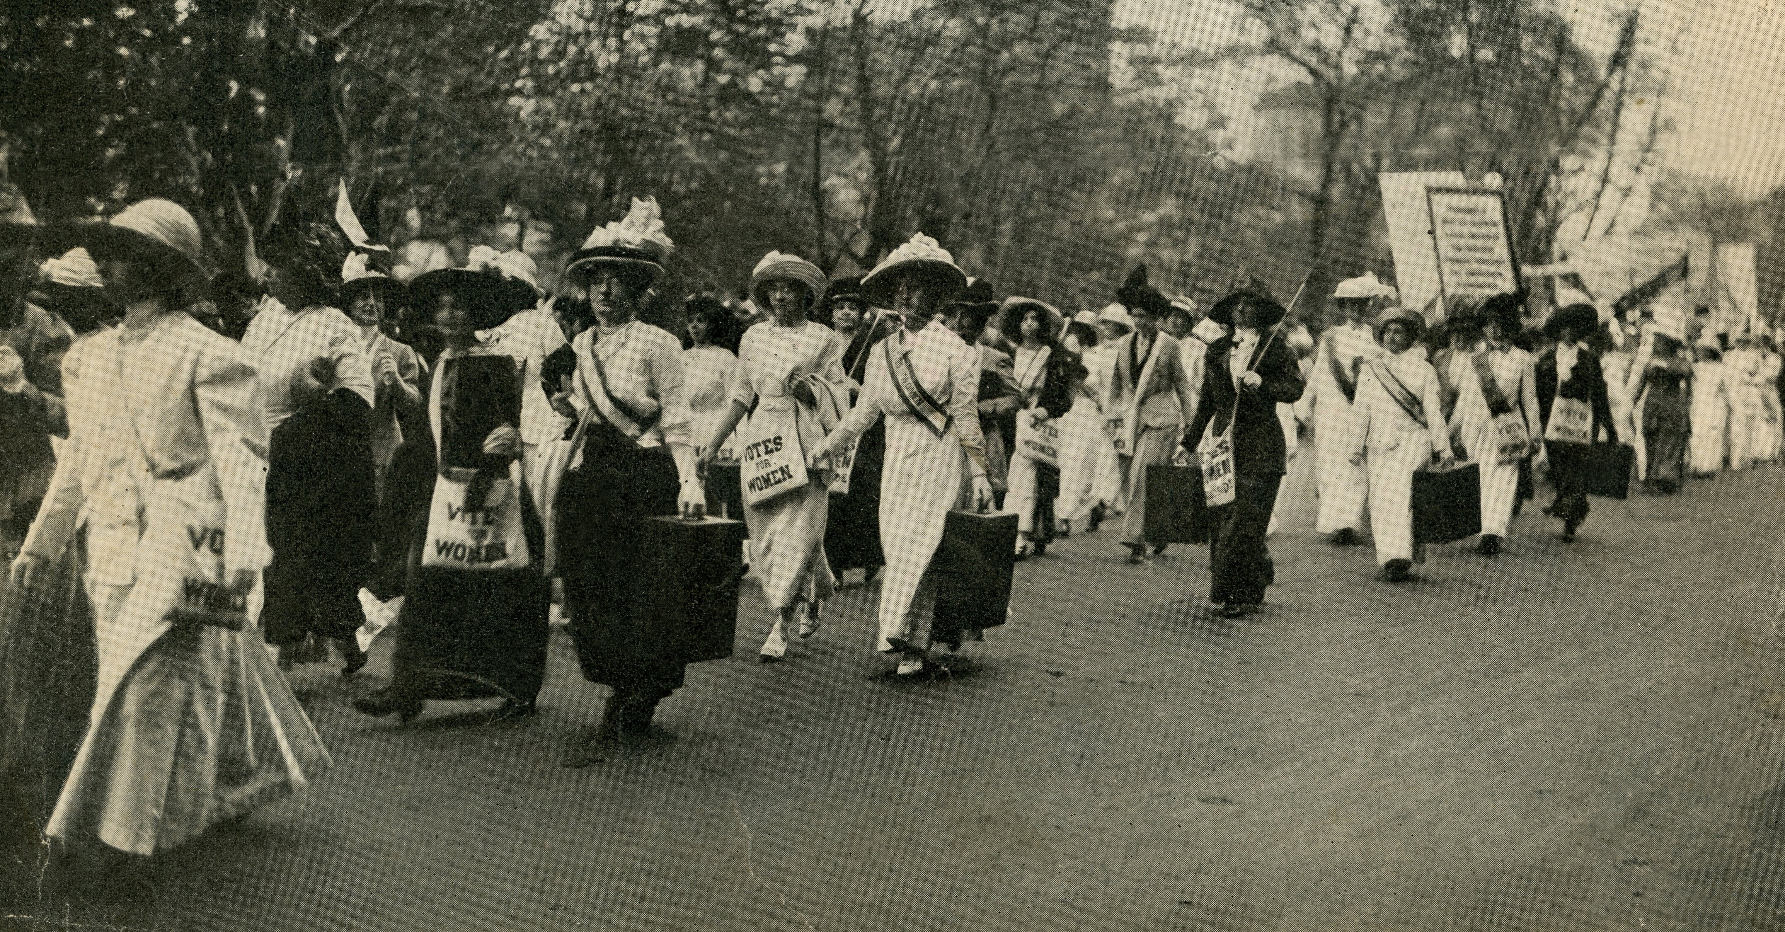
Your voice matters!
Inform your vote.
Don’t let someone else decide who represents you.
Use Vote411.org a non-partisan online voter guide from the League of Women Voters®
Vote in Washington State’s
General Election October 19 – November 6
Use Vote411.org a non-partisan online voter guide from the League of Women Voters®
Washington State General Election October 19 – November 6

Slide 2
Your voice matters!
Inform your vote.
Don’t let someone else decide who represents you.
Use Vote411.org a non-partisan online voter guide from the League of Women Voters®
Vote in Washington State’s General Election
Ballots mailed October 19 Return by November 6
Vote in the Washington State General Election
Ballots mailed October 19 Return by November 6
Use Vote411.org a non-partisan online voter guide from the League of Women Voters®

Slide 3
Postcard Front/Back: General
Front
Back
Don’t let someone else decide who represents you.
General Election
October 8 – Deadline for online voter registration and address change
October 19 – Start of 18-day voting period, ballots mailed
October 29 – Deadline for in-person new WA State voter registration
November 6 – General – Postmark (free postage) or use a local drop box (close at 8pm)
Don’t forget to mail in your ballot or use a local drop box by November 6 – postage is free!
Visit www.sos.wa.gov/elections for more information about Washington State Elections
Visit www.lwvwa.org for more information about The League in Washington State
Inform your vote! Use VOTE411.org from the League of Women Voters, a non-partisan online voter guide

Slide 4
Primary and General Election reminder handouts
Front
Back
General Election Deadlines
October 8 – Deadline for online voter registration and address change
October 19 – Start of 18-day voting period, ballots mailed
October 29 – Deadline for in-person new WA State voter registration
November 6 – General – Postmark deadline (free postage) or in a local drop box by 8pm
Don’t let someone else decide who represents you.
Your vote matters!
Don’t forget to mail in your ballot or use a local drop box – Postage is Free!
General Election October 19 – November 6
Visit www.sos.wa.gov/elections for more information about Washington State Elections
Visit www.lwvwa.org for more information about The League in Washington State
Inform your vote! Use VOTE411.org from the League of Women Voters, a non-partisan online voter guide

